Slide 1
Auckland Region Community Funding Fair Presentation Auckland Council
Michael Alofa, Specialist Advisor
March 17, 2022

Slide 2
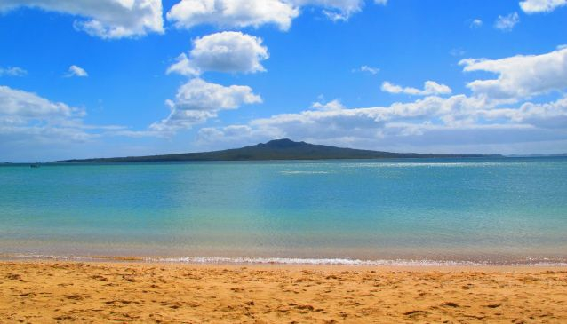
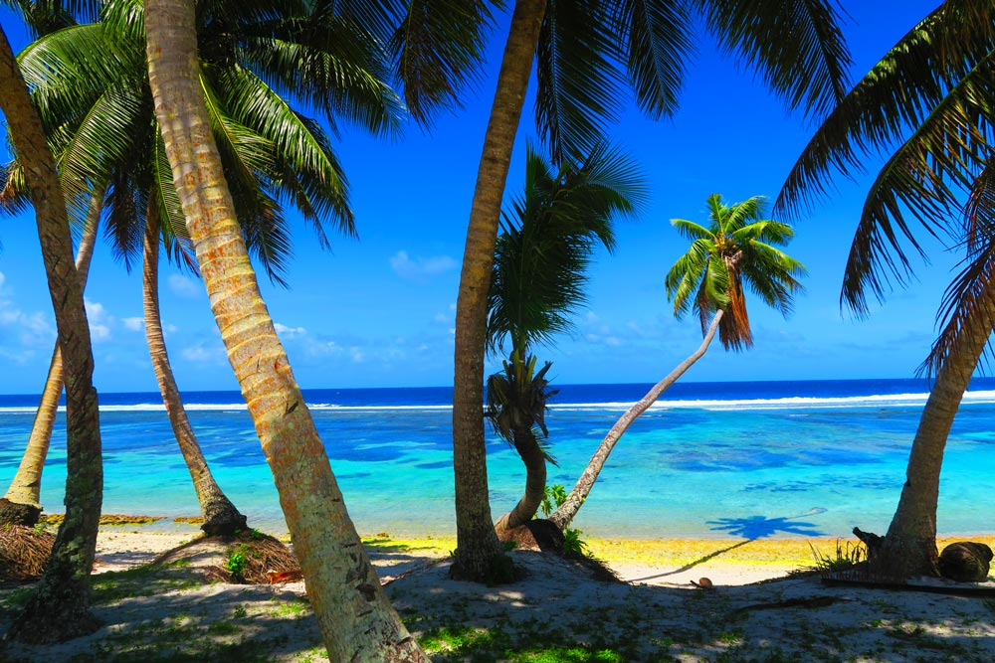
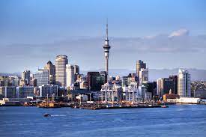

Slide 3
Connected Communities:
Michael Alofa, Specialist Advisor.
Delivers the annual work programmes for the 21-local boards.
Each local boards – has one ‘strategic broker’.
Programme Delivery Teams – across Tamaki Makaurau.
Programme Delivery Team – Clusters.
North-West:
5-North local boards
3-west local boards

Slide 4
Auckland Council
Mayor
20-Councillors / Wards
21-Local Boards
CCO-Council Controlled Organisations
IMSB-Independent Māori Statutory Board
Advisory Panels

Slide 5
Estimated population of Auckland 2021
Population 2021
1.715.600
Population 2020 1.716.900
2018:
European -54%
MELAA – 3%
Asian – 28%
Pacific – 16%
Māori - 12%

Slide 6
Grant Themes for consideration:
Community Initiatives
Sports & Recreations
Arts
Events
Environment
Cultural initiatives
Heritage
Waste

Slide 7
Council Funding Opportunities:
Smarty Grants
Contestable Funding
Local Board Quick Response Funding
Local Board Work Programmes

Slide 8
Funding Agreement consideration:
Funding Agreement
Legal Entity Status
Why? Purpose of your community initiative?
Objectives, deliverable, timelines & Outcomes
Align your project to the local plan, ‘outcomes’
Accountability Reporting
Trust & Relationship

Slide 9
