Slide 1
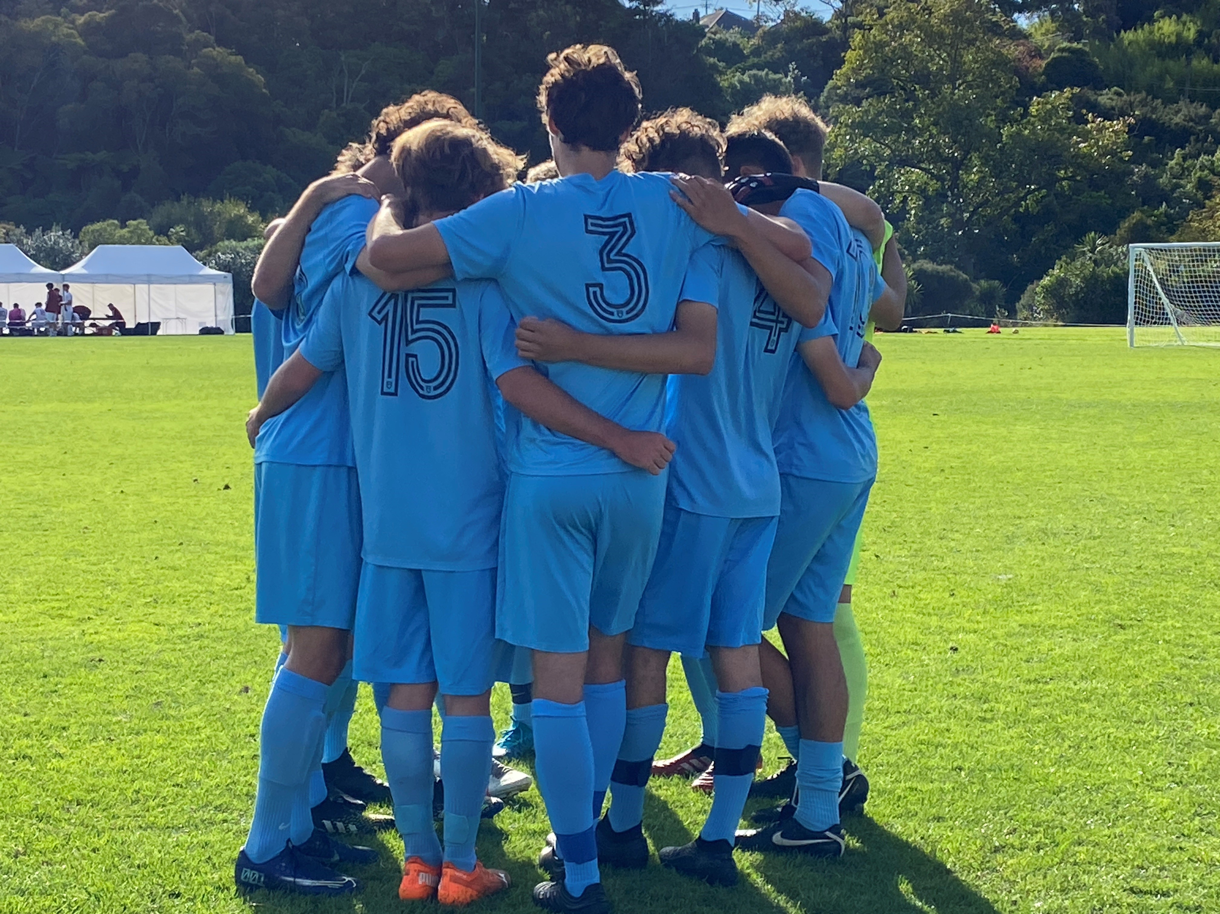
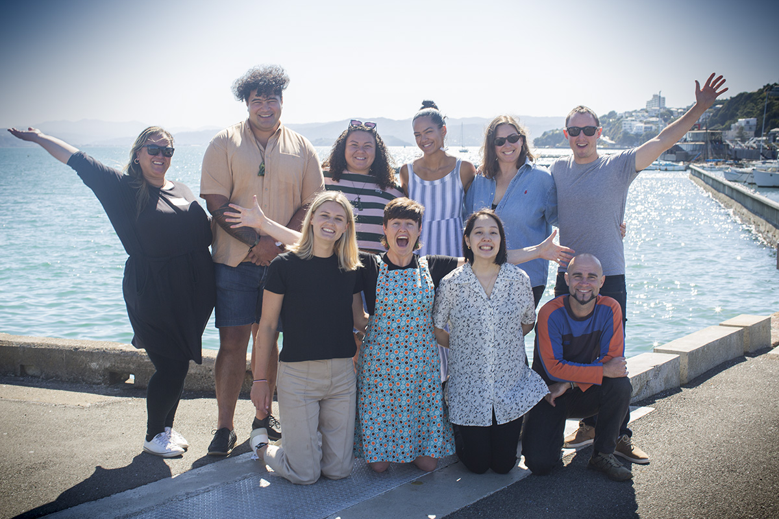
Class 4 Funding information

Slide 2
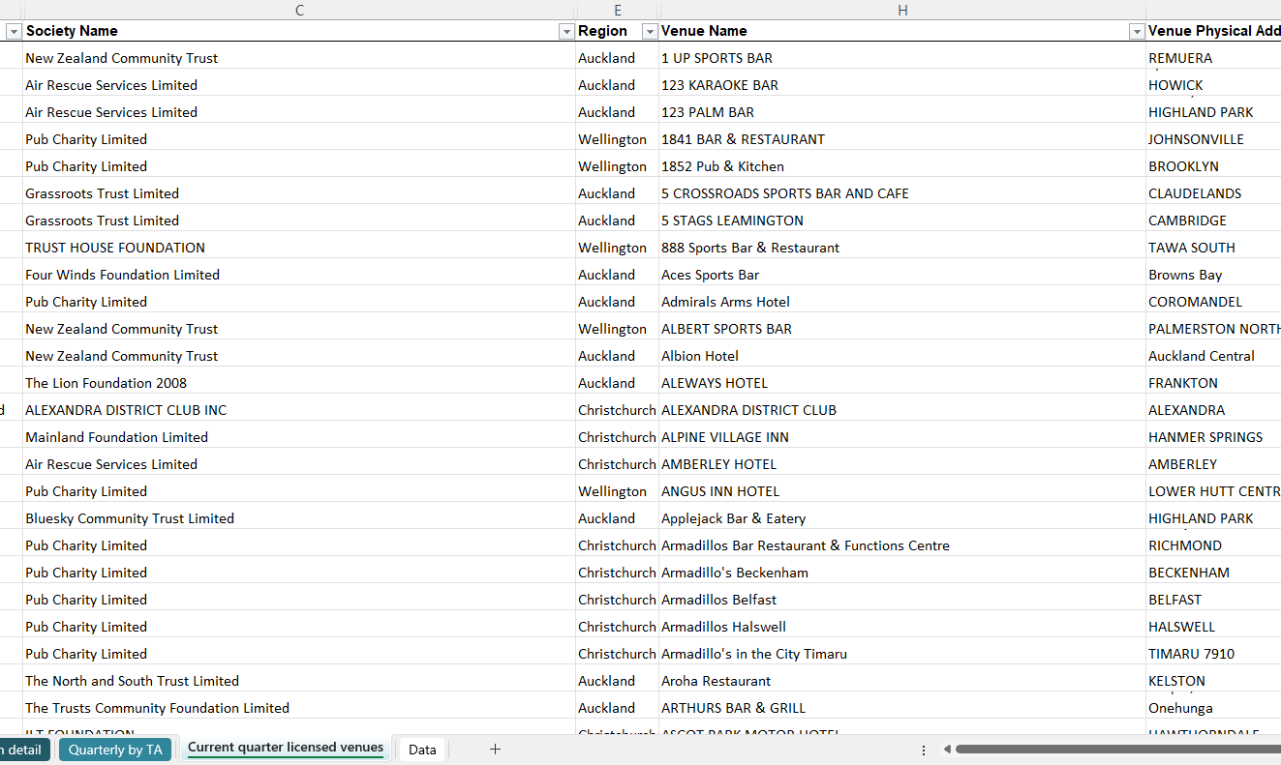
Class 4 Sector in NZ
Over 37 different societies run Class 4 gaming venues in NZ.
All these societies operate differently, fund different things, have different interests, use different systems.
Very advantageous to know what societies are in your area and the kinds of things they prefer to fund.
Visit the DIA website to see what other Class 4 societies are out there.
https://catalogue.data.govt.nz/dataset/gaming-machine-profits-gmp-dashboard/resource/60081bcd-f2ae-4b97-8a9f-fe449fa59969

Slide 3
Criteria For Funding
Please remember that the majority of rules and regulations are determined by the Gambling ACT. But C4 societies do have a few of their own rules.
The Lion Foundation/ Pub Charity Limited / New Zealand Community Trust
All grants can only be made for Authorised Purposes.
All return funds locally ( ie need to have venues in the area) . But do apply and distribute funds generated from one area into another area where it is considered that there is a community of interest between the two ( or more) areas
All fund correctly incorporated organisations
Will not fund organisations who operate their own gaming machines
All require previous accountability reports to be finalised
Pub Charity – https://www.pubcharitylimited.org.nz/assets/Documents/PCL-5054-Online-Donations-Criteria-and-licence_1-v2.0.pdf
NZCT – https://www.nzct.org.nz/faqs/#grants

Slide 4
Criteria For Funding- TLF
TLF SPECIFIC POLICY
TLF is itself a Charitable Trust – must distribute for Charitable Purpose as well as Gambling Act.
Charitable Trust - provide Charities Commission registration. Trust Board can be incorporated in terms of Charitable Trust Act.
Incorporated Society – must be not for profit, must provide IRD income tax exemption as proof (schools exempt) .
Information about Income Tax Exemptions is available on our website.
Sport clubs should be affiliated to a regional body. We do sometimes talk to National body for advice.
One successful grant within a 12 month period.
Prefer that your organisation is within 5km’s of a Lion Foundation venue (usually). We may sometimes relax this rule – make a call to a Grants Advisor.
The audit from your previous grant must be completed.

Slide 5
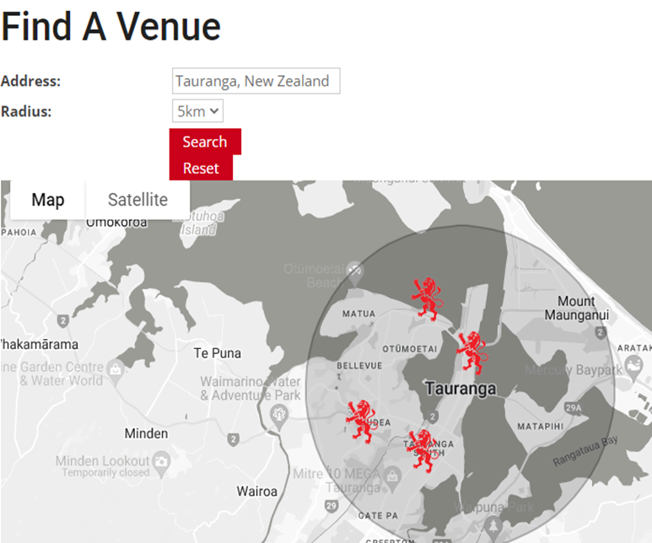
Key Funding Points- TLF
All inclusive funder – TLF funds Sports, Education, Health, Arts/& Culture.
TLF will be phasing out applications in paper form- apply online.
Applying online – please take a few minutes to read the Step by Step Guide available on our website.
Funding is distributed to areas where money generated – so it is important to know where the TLF venues are.
To find a TLF venue – use the tool provided on our website - https://lionfoundation.nz/venues/
If there is no TLF venue in the area in which you operate – it is unlikely that a grant will be approved.
Research is key to success

Slide 6
Key Funding Points- TLF
Provide all information. Applications missing info will be delayed or possibly declined. If in doubt, or if you need assistance – please contact the relevant grants advisor.
Grant applications take a lot of work – so keep it simple for yourself. Apply for things that are easy to prove and easy to satisfy audit/accountability requirements. Not all funding has to have a “wow” factor.
Quotes - Internal budgets and estimates of costs are not accepted . Genuine quotes must be provided - two competitive quotes are usually required. If unable to provide two quotes, provide a genuine reason.
Quotes must be addressed to the organisation applying for funds. They must be dated. Address of vendor should be clearly ascertainable.
Be aware that quotes and costs will be verified.
When applying for salaries/wages – please consider Privacy Act implications. Obtain express permission to share the Employment Contract in support of your application. TLF will assume that you have consent.

Slide 7
Key Funding Points
All grants can only be made for Authorised Purposes.
Grants distributed must be used for the specific purpose it was applied for AND approved. This question below is therefore quite important and assists the Grant advisors in determining whether or not the purpose is an Authorised Purpose :
Once a grant has been approved, it is very rare that Authorised Purpose can be amended. If you have asked TLF to amend the Authorised purpose and we are able to do this - please insist on a confirmatory email☺.
Unauthorised spending of grant funding will result in a request for a refund of said monies.
Audit - Adhere to the audit timeframe – this is determined by the grants advisor when assessing your grant. If you encounter timing problems – communicate sooner rather than later. Insist on an email if we agree to change timeframes ☺.

Slide 8
Key Funding Points- TLF
If your project requires resource or building consent – please don’t apply until these are approved and in hand.
There are no “cut off dates” – but please allow at least 8-10 weeks from start to finish.
There is no “magical amount” that you can apply for. Try not to rely on a grant from TLF. Funding decisions take a variety of factors into account –
- What other grants are there and how many pieces can the pie be cut into
- How much money is available (we cannot distribute more than we have available)
- Community benefit
If you are a first-time applicant – it will pay to reach out to the team to discuss your organisation, the grant application process and the do’s and don’ts. There are certain things that cannot be funded – do your research

Slide 9
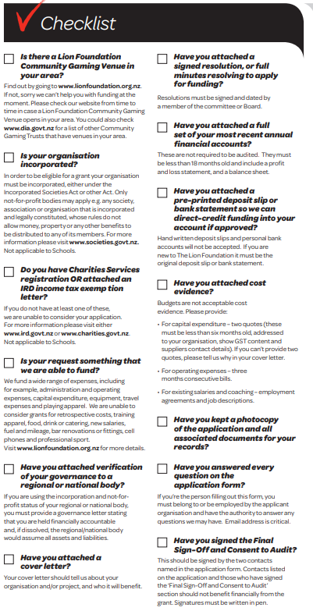
What We Need – TLF
Checklist on Website
Allow 8 – 10 weeks for a decision
We can receive up to 500 applications in a month – Ensure that your paperwork is correct.

Slide 10
If You Are Successful – all C4
Wait for formal confirmation – this is usually done by way of email. If the money is paid into the bank account – but you have not received an email – get in touch.
Read the email – specific information is conveyed to you.
Spend the money! But remember – only on what you are permitted to spend it on – Authorised Purpose.
Complete the audit within the stated timeframe but ideally complete it as soon as possible.
5. Share your organisations success and the impact of the grant .

Slide 11
How Can You Say Thanks?

Slide 12
Any Questions?
The Lion Foundation website is a great resource. If you are unsure of anything, that should be your first stop.
www.lionfoundation.org.nz
All your grants team contact details are there also.
Sam Alexander – National Compliance & Grants Manager
Shilpa Patel – Senior Grants Advisor
Phone number 0800 802 908

