Slide 1
A Guide
to the
Z Energy
Good in the Hood programme
Notes:
Thank you to ANCAD for the opportunity to speak to so many of you around the work Z Energy does in the community and how we may be able to offer support through Good in the Hood.

Slide 2
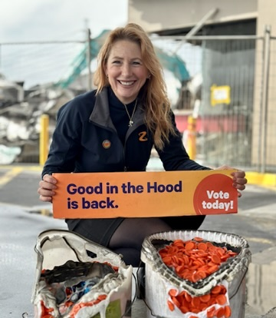
Melanie Kennerley
Community Champion and Z Retailer in East Auckland, South Auckland and Franklin
Notes:
I have been asked by Z Energy to represent them in explaining how Good in the Hood works. There are 16 Retailers like my husband and myself covering NZ and operating in specific regions. GITH is a programme that is enabled by Z but implemented on the ground by retailers like myself. As I explain a bit more about it and it’s history you’ll see why. Another thing to note is that as I walk you through GITH, many of the local on the ground aspects differ from retailer to retailer. How I run Good in the Hood across our cluster of 17 stations will differ to what some of the other Retailers do, but I’ll try to highlight that where it is applicable.

Slide 3
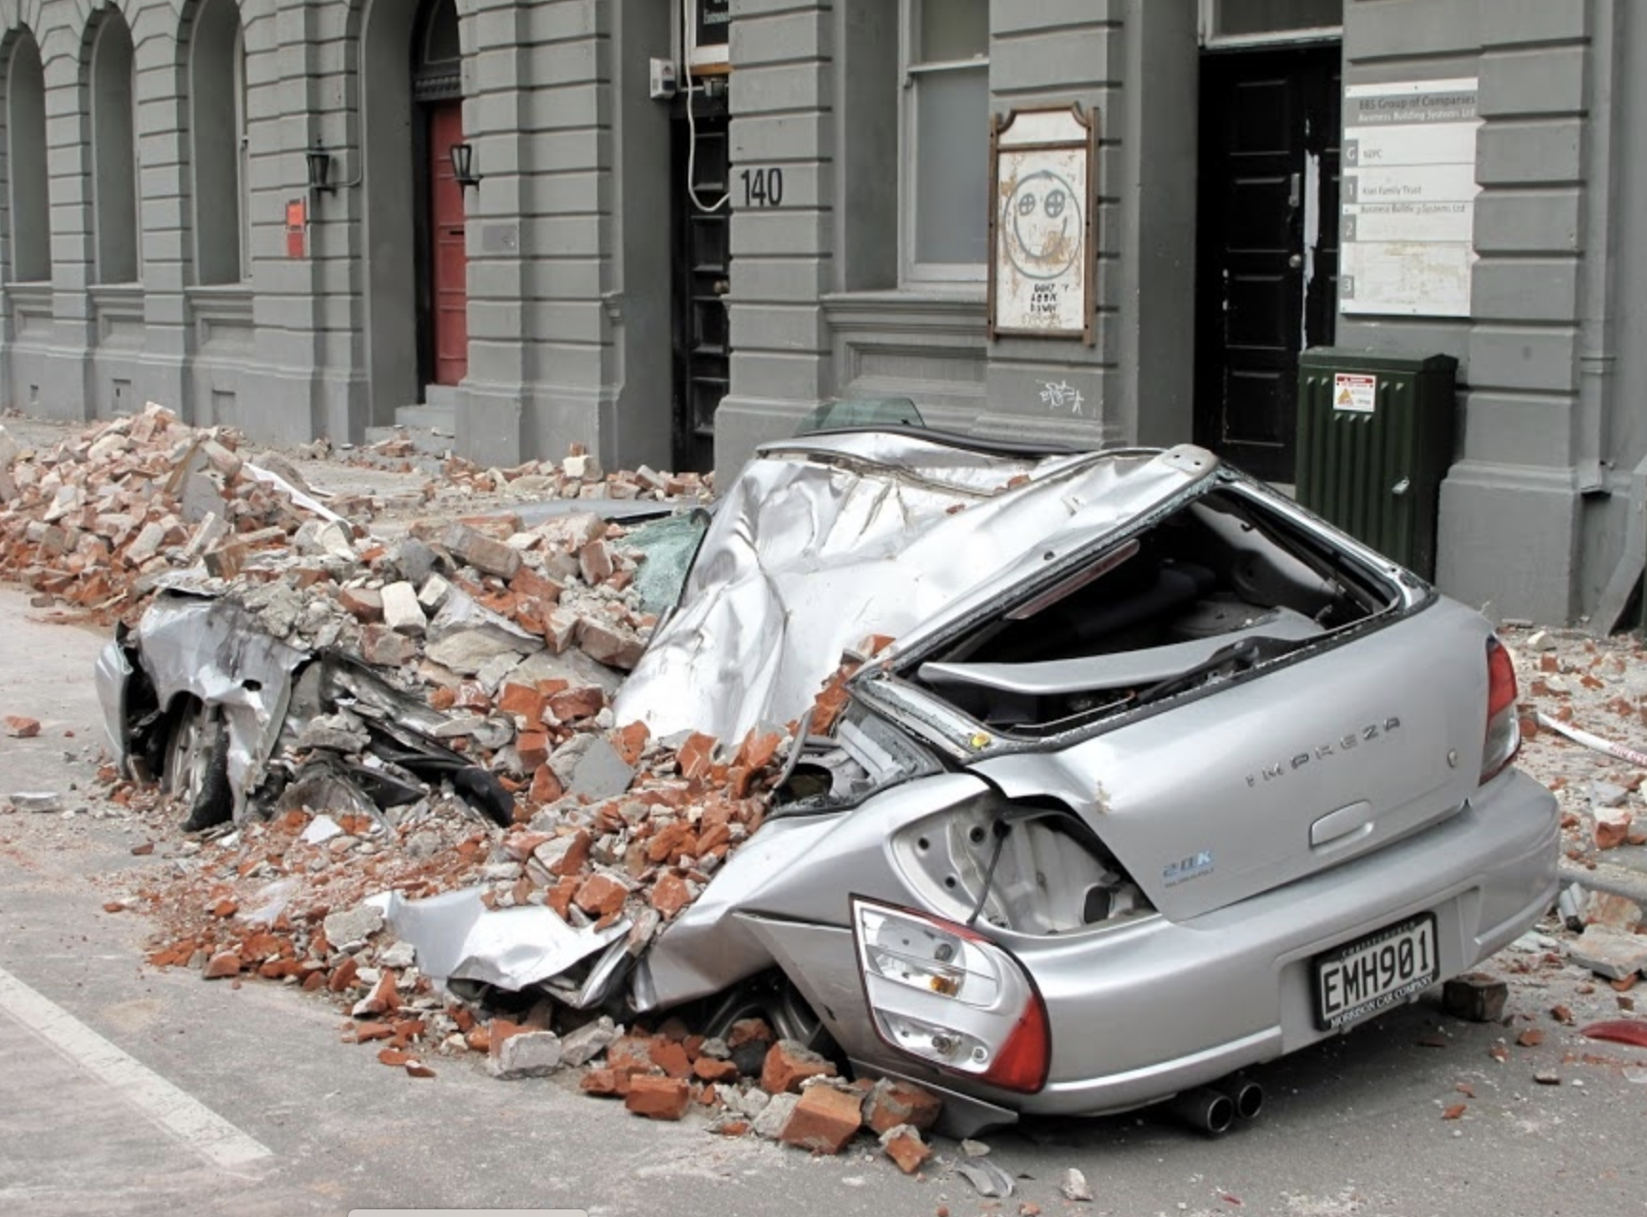
Good in the Hood (GITH)
began with the first Christchurch Earthquake
4th September 2010
Notes:
So how did GITH begin. It actually came out of the first Christchurch earthquake in 2010 where the government asked large corporates in NZ to contribute significant amounts of money to a central pool that they would then manage to try to help Christchurch. Z Energy decided to not do that but instead to give funds to the Retailers and their own staff who were on the ground to distribute based on where they saw the need at the time. This was done without any fanfare, the public never knew, it just happened. They did the same again last year after the floods and cyclone where they asked those of us in the affected areas to help with letting them know where the need was. However, back in 2010 Z Energy got such great feedback about what those donations in Christchurch did that they sat down and worked out how to turn what they did into an official programme. It took a couple of years but in 2013 Good in the Hood as we know it now was born.

Slide 4
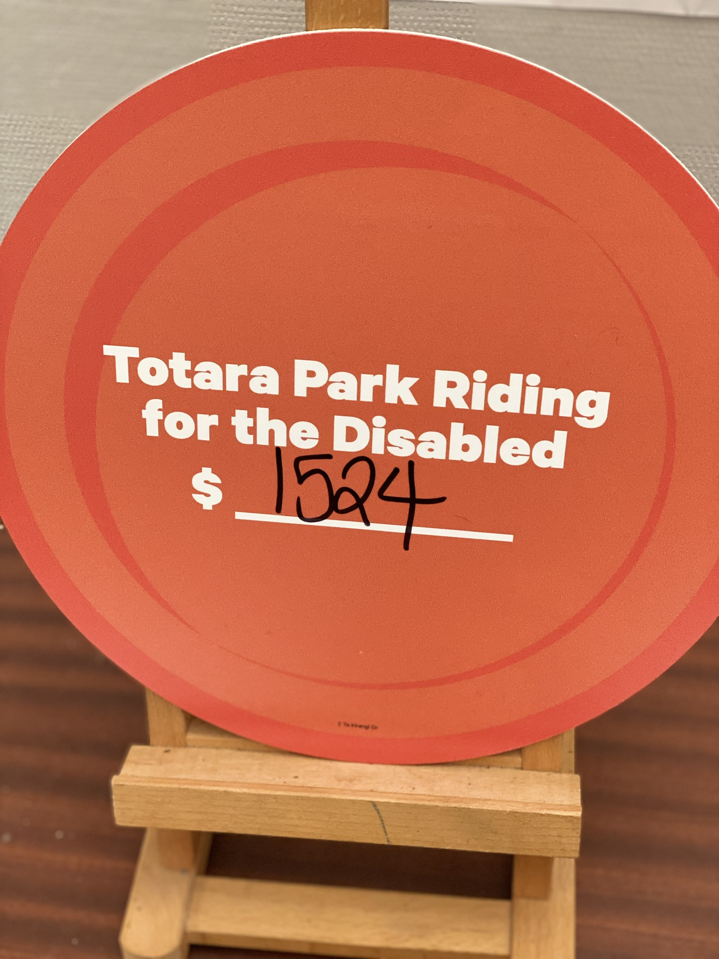
Since then Z Energy have made over $10 million in donations to community organisations and charities throughout New Zealand.
Notes:
Z has now donated over $10 million to groups across New Zealand through Good in the Hood and to a hugely diverse range of community organisations and charities. The important aspect of the programme is that it is local, with the groups selected doing work in the specific neighbourhood and community around their local Z station. Those groups are either helping people within the community or the environment in that area.

Slide 5
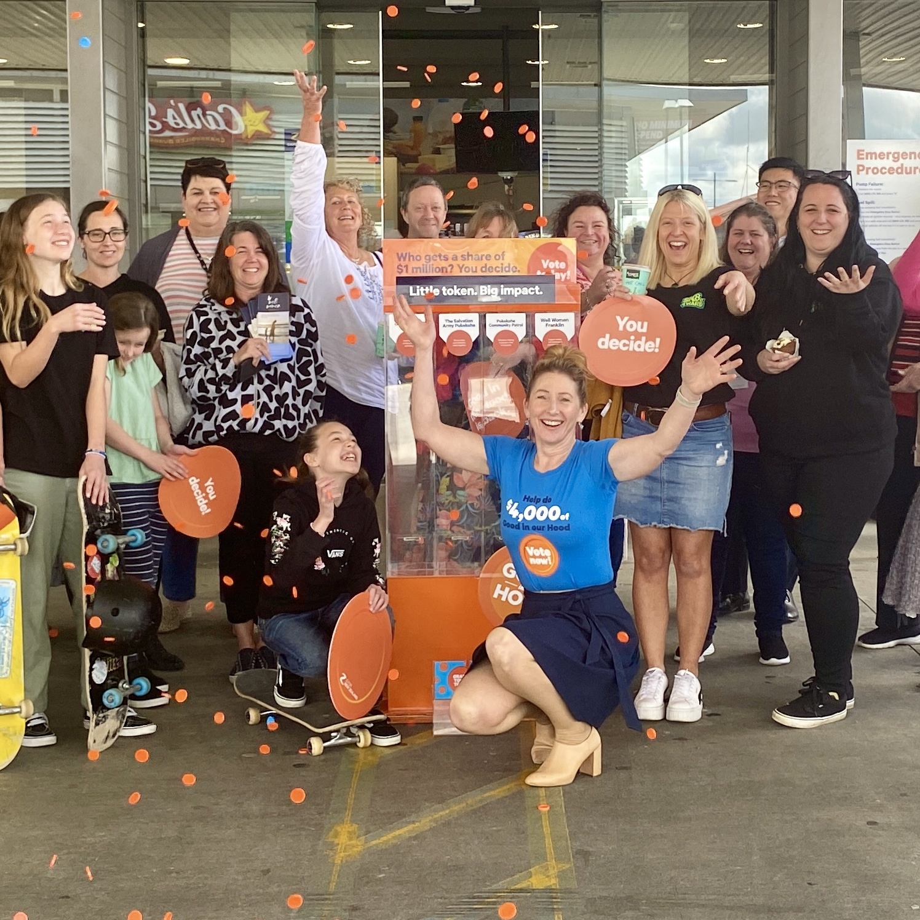
How does Good in the Hood work?
Every year each Z service station across NZ gives away a total of $5,000
$4,000 is voted on by customers
$1,000 is discretionary funding
Notes:
I’m sure most of you will have seen Good in the Hood when it is taking place each year. Each year, groups get to apply, 4 groups are selected for each service station and then the customers using that service station get an orange token during the voting period and they use that token to vote for their favourite group. At the end of the months voting period the $4,000 is split across the 4 groups in proportion to the customer voting. It is always fascinating to see how the community votes.
Across the year we also receive $1,000 of what we call discretionary funding per Z station and as Retailers we can chose what groups and activities we support with this.

Slide 6
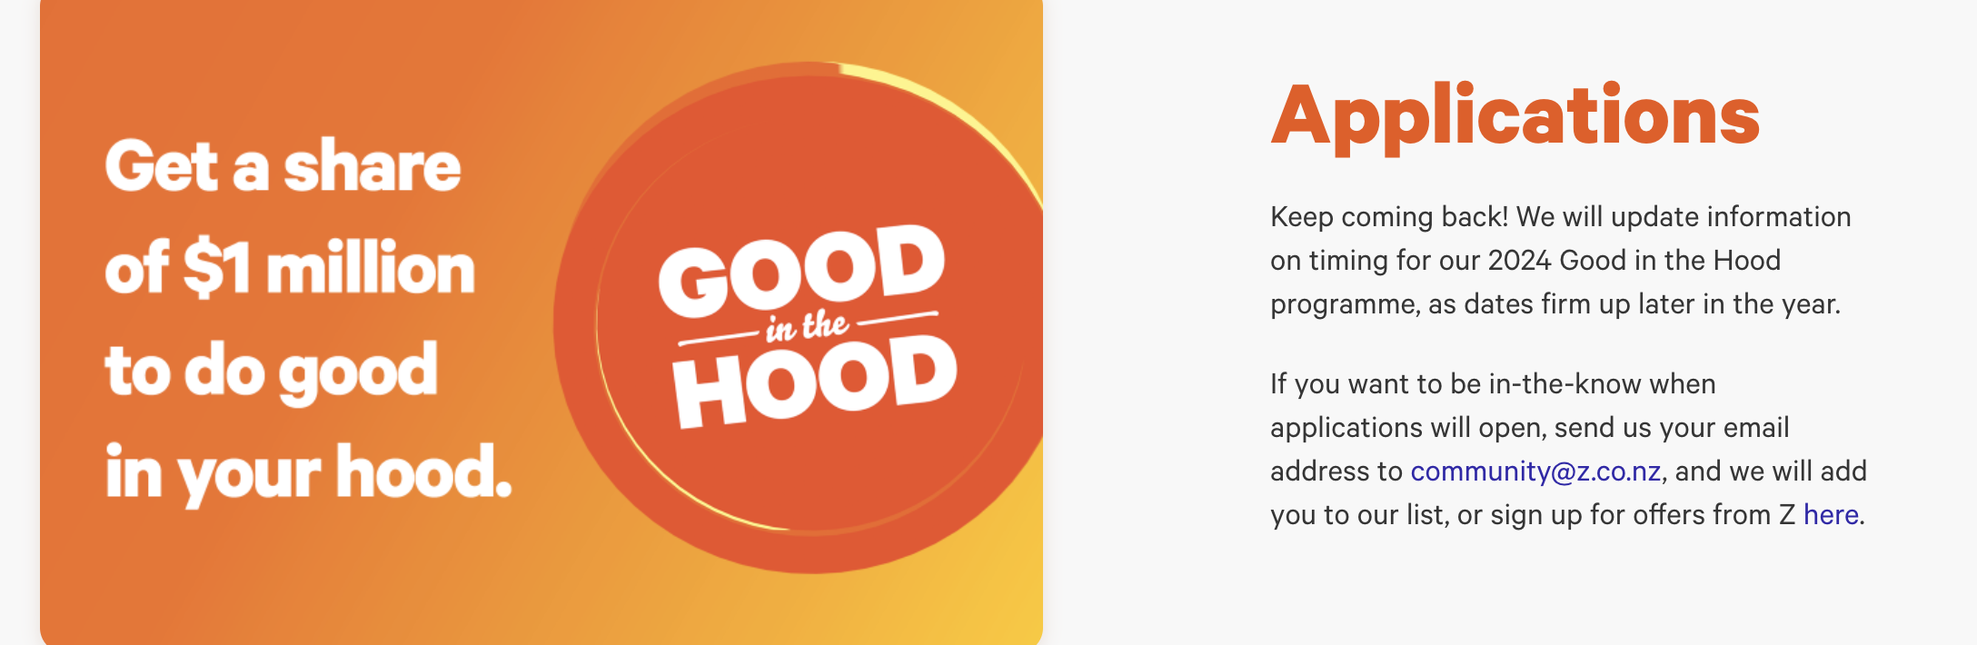
How to Apply
Last year applications opened for the month of July
Keep an eye out at z.co.nz for when applications open
Notes:
I’m going to walk through the whole process with you so you’ll get more understanding of it. Please be aware that the timings of GITH aren’t confirmed yet for this year so I am using the timings of the last couple of years as I believe it will be similar. Applications for GITH opened in July last year. This shows what you will see if you currently head to the Z website to apply. If you aren’t already on your local Retailers email database for GITH then it might be good to add your email address to the general Z database for GITH as they will then let you know when applications are open.

Slide 7
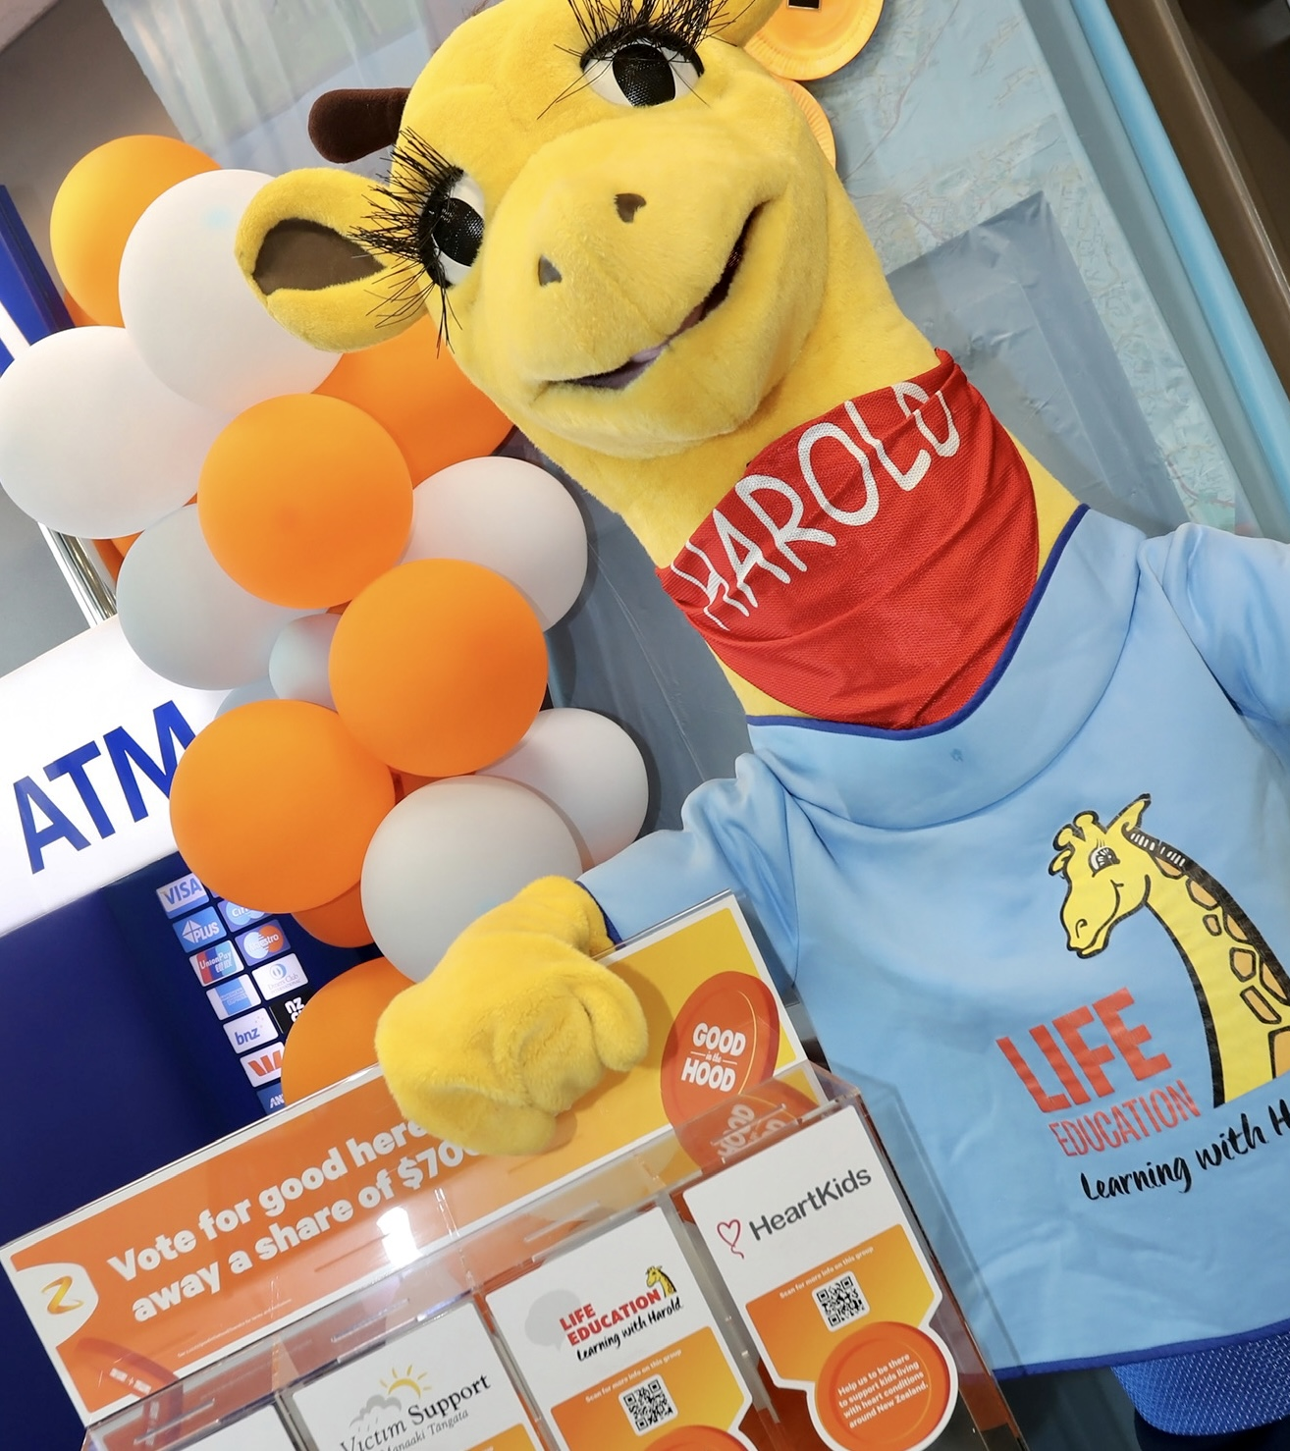
Who Can Apply?
Charities or Community Organisations helping people or the environment
Notes:
As I mentioned earlier, GITH is about supporting those groups and charities in NZ that are supporting people and the environment in our communities. It is about being local. So as long as you help people or the environment then you are good to apply. One thing to note is that you don’t have to a very specific programme or piece of equipment that you are needing the money for. When you receive it, it is at your discretion to use as you see best. Retailers and Z do like to get feedback on how you have used your funding though.

Slide 8
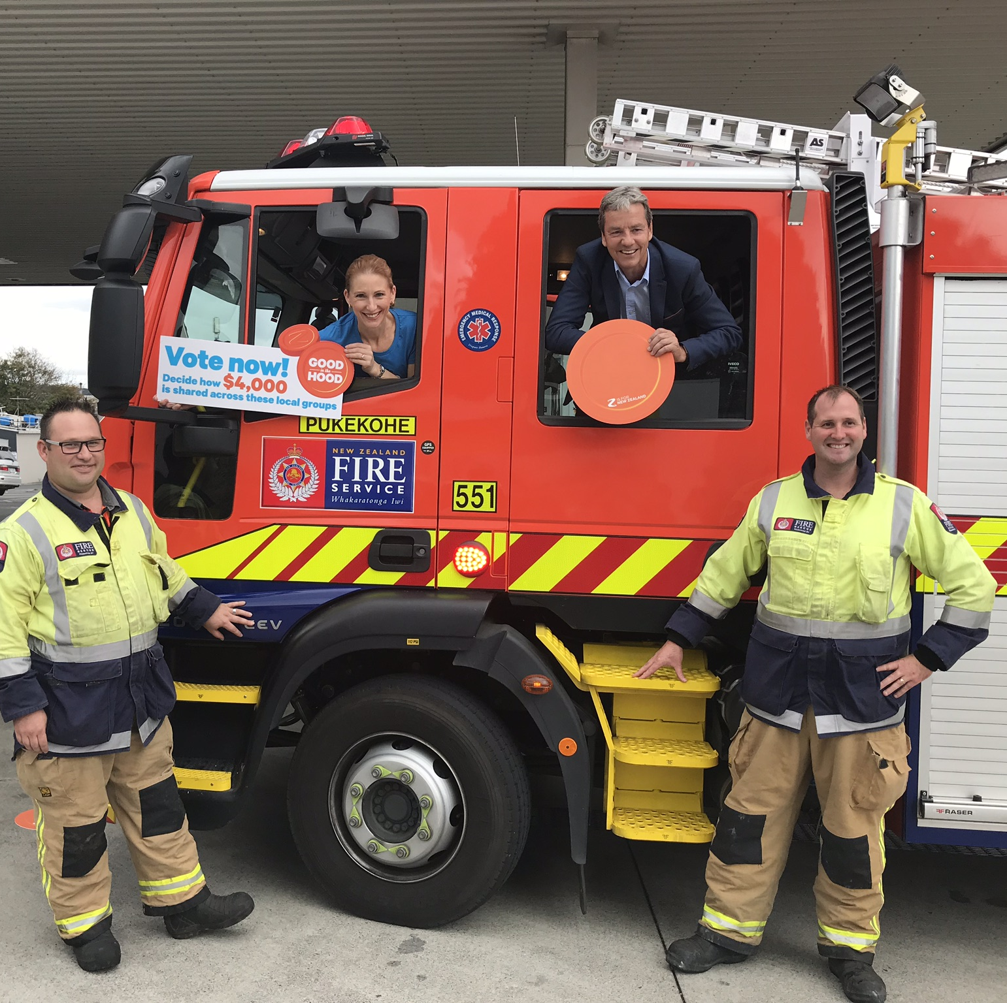
Applications are fully online with a series of details to fill in.
Notes:
Applications are only available to be completed from the Z website. There are a number of sections to fill in which will help confirm if you are suitable for the GITH programme and then also help the Retailer select their 4 groups per site from.

Slide 9
Name
Operating Region
Local Z Station
Impact Your Charity has on the Community
Difference Made in the Last 12 Months
Need Your Group is Helping to Meet
Notes:
These were the main questions last year that each group needed to fill in. Please note that you can apply for more than one Z station if the area you are supporting covers a larger area of the community. And in some cases you may be selected to be in more than one Z station. Again, this is purely at the discretion of the Z Retailer in the area you are applying for. I have some groups that only operate in the area we look after, for example Totara Hospice but they cover most of our stations and I may select them for more than one station.

Slide 10
Then the hard work for Retailers begins with reducing 30 - 40 applications per site to 4.
Notes:
Once applications close they get sent through in a very large spreadsheet to each Retailer. We are the responsible for narrowing down around 30 to 40 applications to the 4 for each site. This isn’t an easy job and this is where each Retailer uses their own judgement based on the groups and the need in their community. Personally, I look at every applicant, and if I don’t know who they are then I will spend time assessing how local they are and understanding what they do. I don’t find it an easy job at all!! If you are selected, then you will receive an email from Z Energy to let you know that. After that you will probably hear from your local Z Retailer with more details relating to your region.

Slide 11
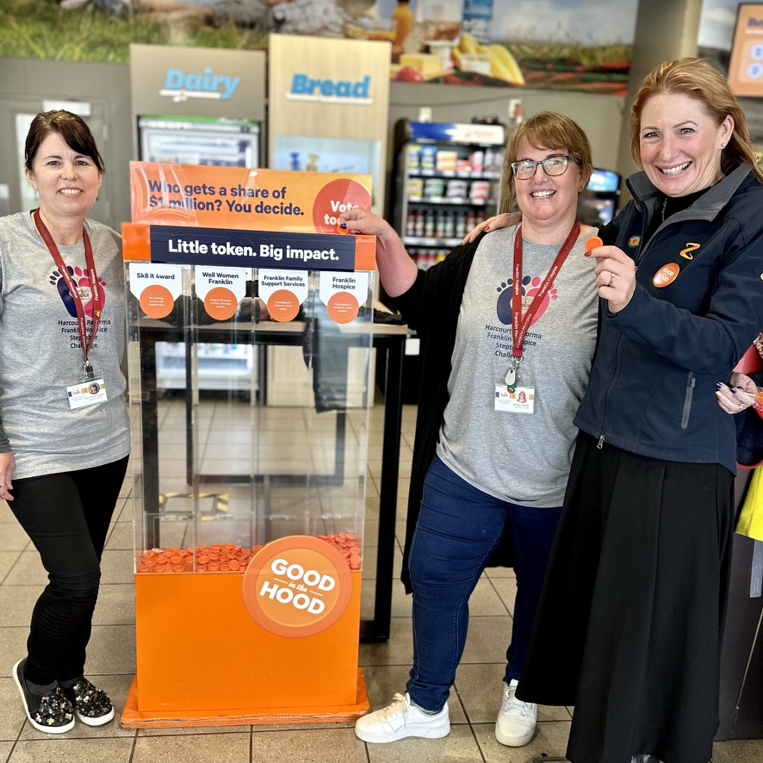
Voting is instore and generally around October for 4 weeks.
Notes:
Voting for GITH generally takes place for 4 weeks across October. Across that period your group is welcome to spend time on site and this is one of the great parts of GITH. This is your chance to spend time talking to members of your community that you may never get to see. Some groups don’t manage to get on site at all, some might come in for one morning once a week. How much or how little is up to you. And you never know what those interactions may lead to. The ladies in my photo above are from Franklin Hospice on the first day of voting instore last year. But Alison previously was in GITH through the local Riding for the Disabled. One converstation she had with a customer while onsite during GITH lead to that customer donating them a horse – so the visibility of being part of GITH is one of those unquantifiable benefits. When you are selected for GITH, Z will also send a social media pack which will help your group promote that you are part of GITH so that you can encourage your supporters to get in store and vote for you, because of course, the more votes you get the more dollars you will get.

Slide 12
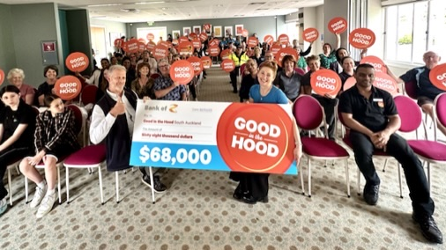
Cheque Presentation 2023
Notes:
Again, each region and Retailer celebrates GITH in different ways. For our stations, I organize an event where all our groups are invited to come along, find out how much money they got and have afternoon tea. In our case, with up to 68 different groups or charities present, around 120 people who are all trying to do good for the same community, there are many invaluable connections made and every year I get feedback that the networking opportunities is another fantastic benefit of being part of GITH.

Slide 13
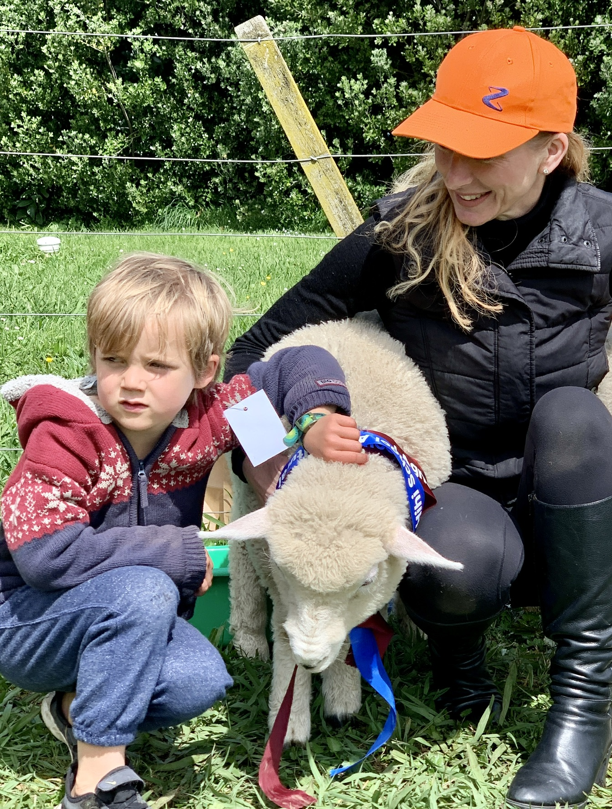
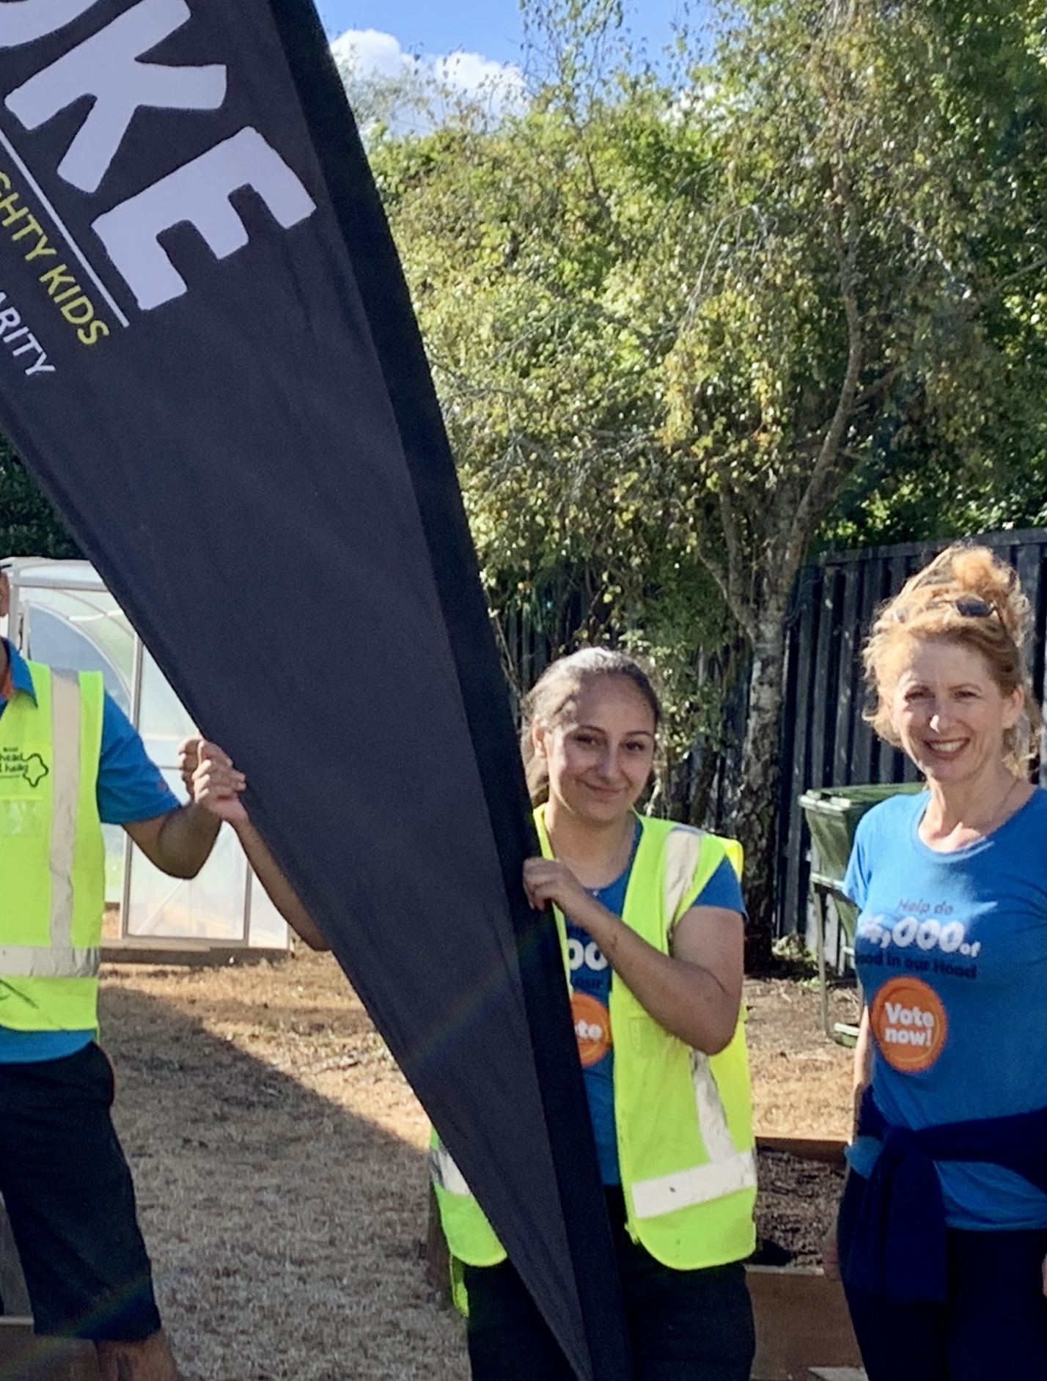
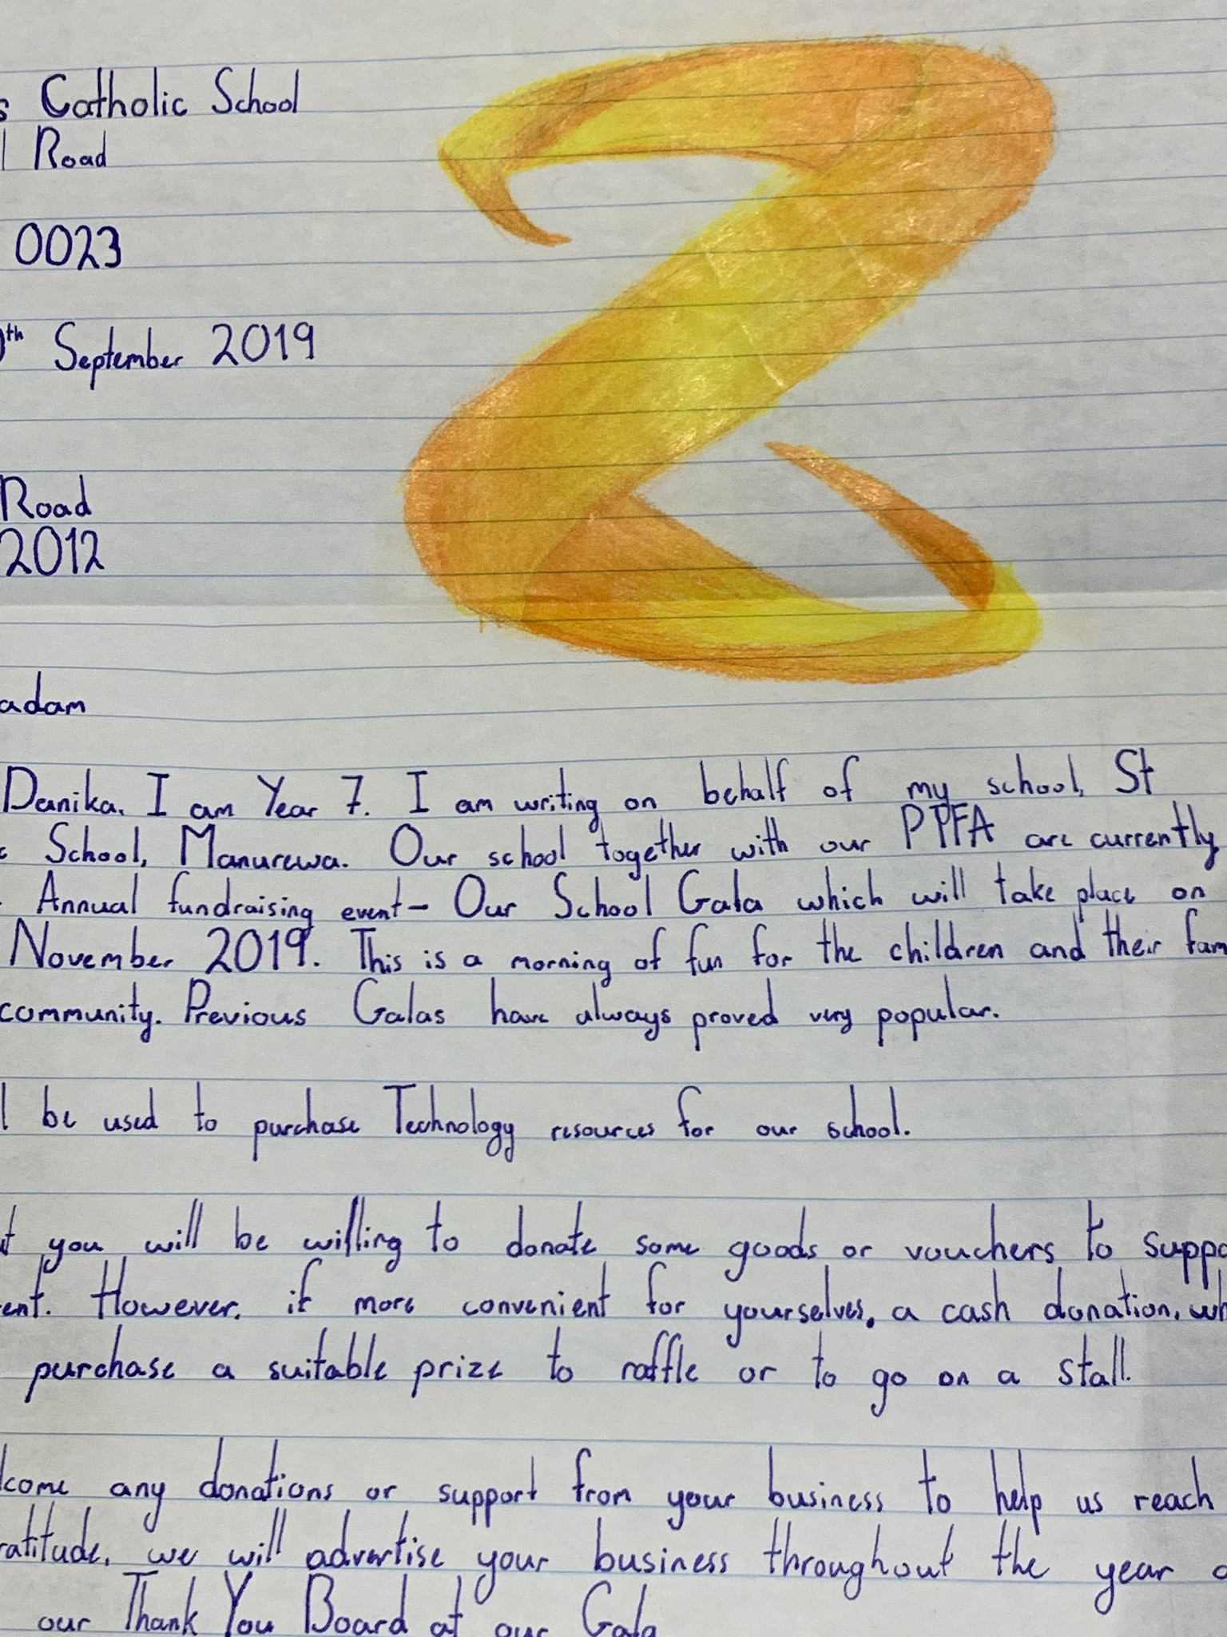
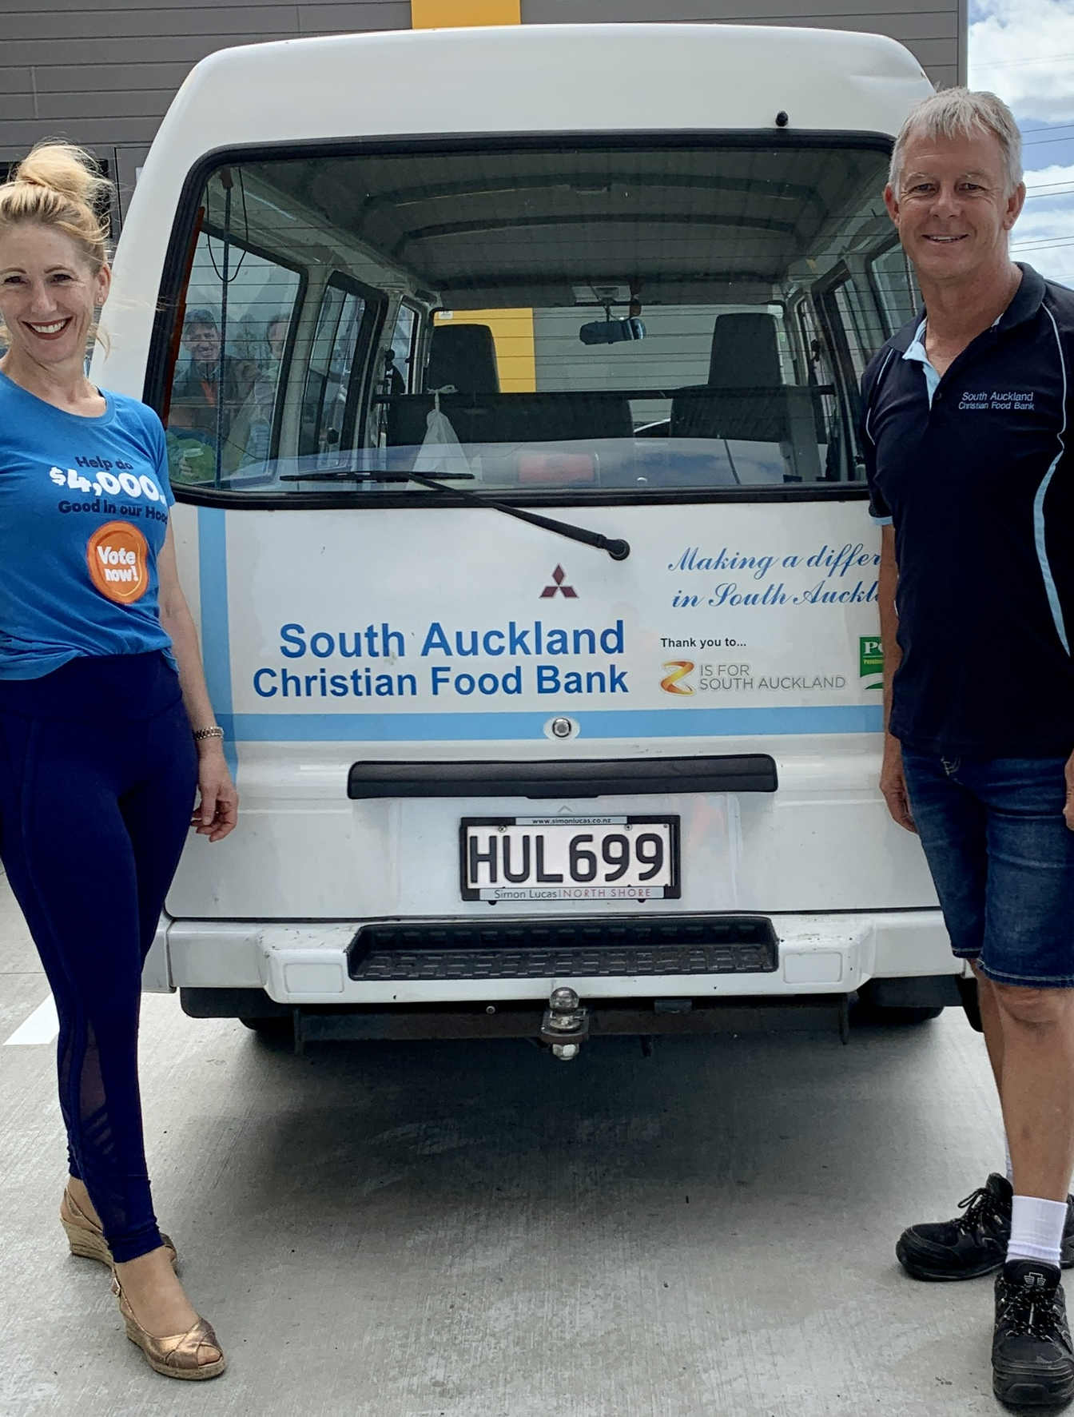
Discretionary Funding Ag Days, Food Bank Donations, School Garden Projects, Hospice Fundraisers…
Notes:
While the main aspect of GITH is the core voting on site, we also have the discretionary funding. This is completely at the discretion of each retailer. In our region, we support all sorts of groups with this funding – lots of Calf Clubs or Ag Days in the Franklin Region, School Galas, donations to the local food bank, sponsoring events such as the local hospice garden rambles or ladies lunches – the list is long.

Slide 14
Melanie Kennerley – Community Champion melanie@kennerley.co.nz

