Slide 1
Josh Martin| Engagement Advisor

Slide 2
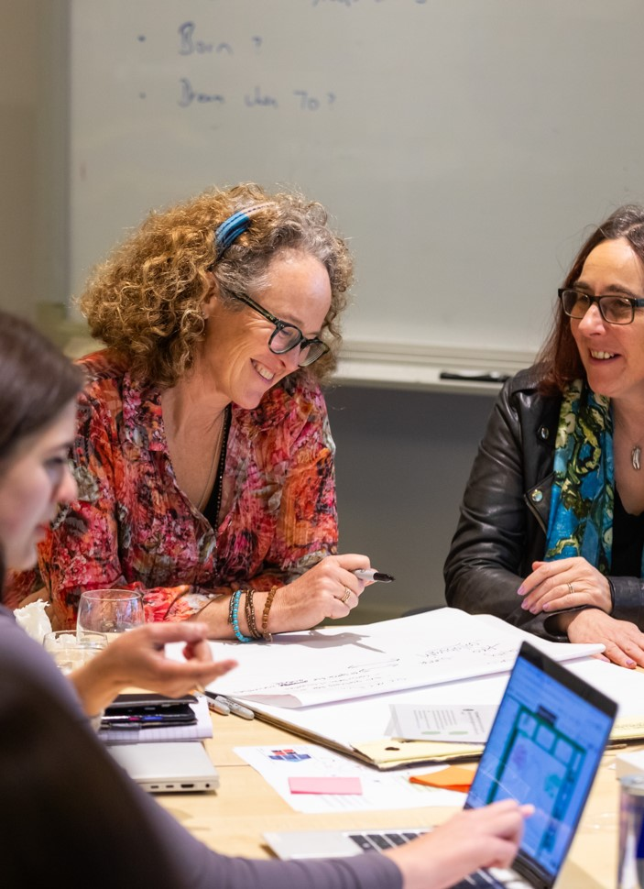

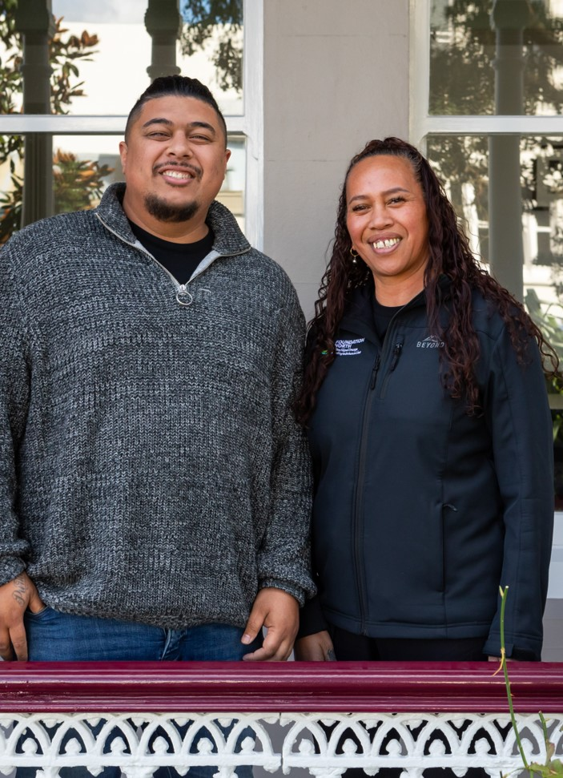
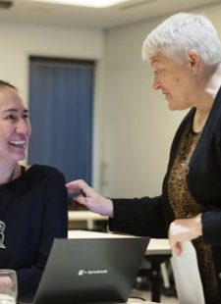
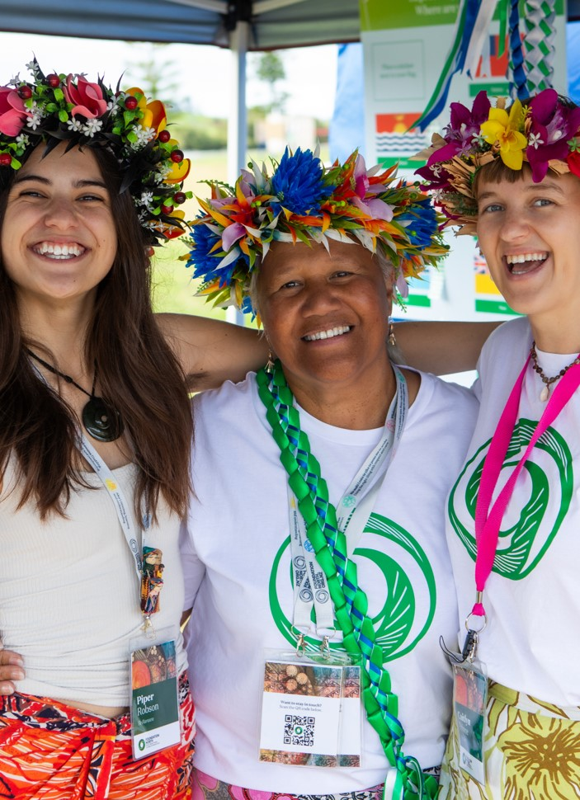
Who is Foundation North?
We are your community trust, created in 1988 from the sale of community shares in Auckland Savings Bank
An endowment/pūtea, invested for the people of Auckland and Northland for generations to come
Returns on those investments mean we can make grants of around $50 million a year to community organisations large and small
Notes:
Include history?:
• In 1988 the Community Trusts Act created 12 community trusts across Aotearoa, formed from the sale of the regional Savings Banks.
• The then ASB Charitable Trust was endowed with proceeds from the sale of the community’s shares in what was previously the Auckland Savings Bank.
• Since that time, we have held that endowment / pūtea in trust for the Auckland and Northland communities, and through our investments have grown it to over a billion and a half dollars.
• The returns on those investments allow us to make millions of dollars in grants each year to not-for-profit groups in Auckland and Northland.
• When the naming rights agreement with ASB Bank ceased in 2015, we became Foundation North.

Slide 3
Our Vision | Moemoeā Whatītike oranga | Enhanced lives
Our Purpose | Tā tātou whāinga Pūtea kaitiakitanga, hāpai oranga
Notes:
Vision | Moemoeā: Whatītike oranga | Enhanced lives
The Foundation is uniquely placed to support communities and enhance the lives of individuals and groups across Tāmaki Makaurau and Te Tai Tokerau. As Te Kaitiaki Pūtea ō Tāmaki ō Tai Tokerau in perpetuity, we are able to take an intergenerational view of the needs and aspirations of our rohe. Our size and scale allow us to support a broad range of community organisations and initiatives and to take risks and support innovative new solutions.
Our Purpose | Tā tātou whāinga: Pūtea kaitiakitanga, hāpai oranga.
To enhance lives through responsible guardianship of our investments and focused funding, anchored by our commitment to Te Tiriti.

Slide 4
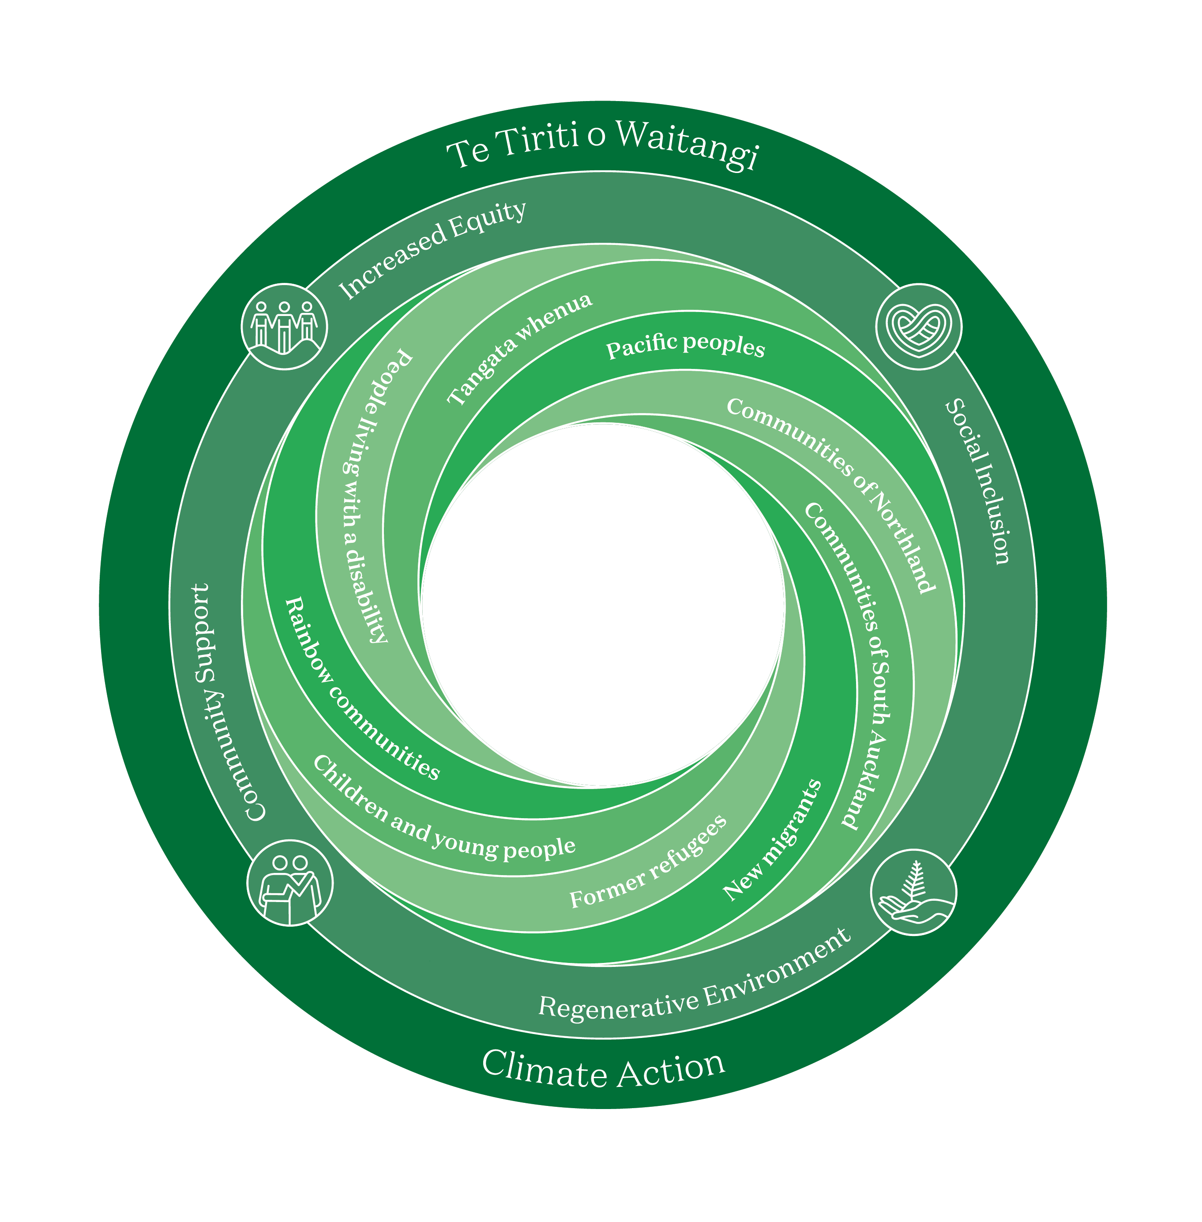

Slide 5




Ngā Hua | Our Focus Areas
Increased Equity
Hāpai te ōritetanga
Social Inclusion
Whakauru mai
Regenerative
Environment
Whakahou taiao
Community Support
Hāpori awhina
Notes:
We want our support to have an impact in four key focus areas, and will ask which one aligns most closely with your organisation.
Which one is the best fit for you?

Slide 6
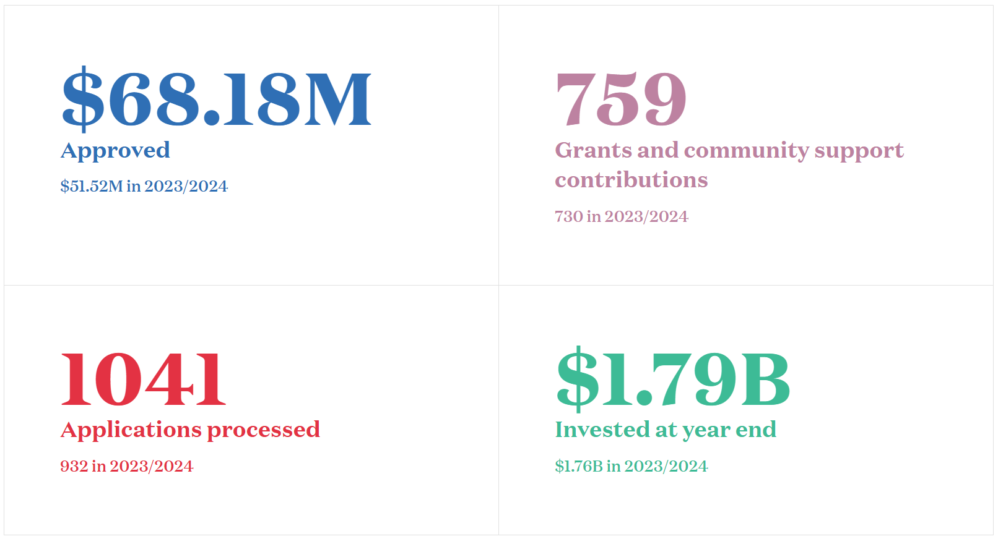
Impact Highlights
Notes:
FY24/25 stats

Slide 7
Funding Framework
Community Funding
Our Quick Response Grants and Community Grants are responsive to community needs and aspirations, and initiatives that contribute to our vision.
Impact Funding
Working collaboratively and creatively enables us to proactively and flexibly fund innovative approaches that advance the kaupapa of our focus areas.
This might include funding prototypes or trial approaches, the seeding of new ideas, investing in building capacity and capability, taking projects to scale and working at systems change.

Slide 8
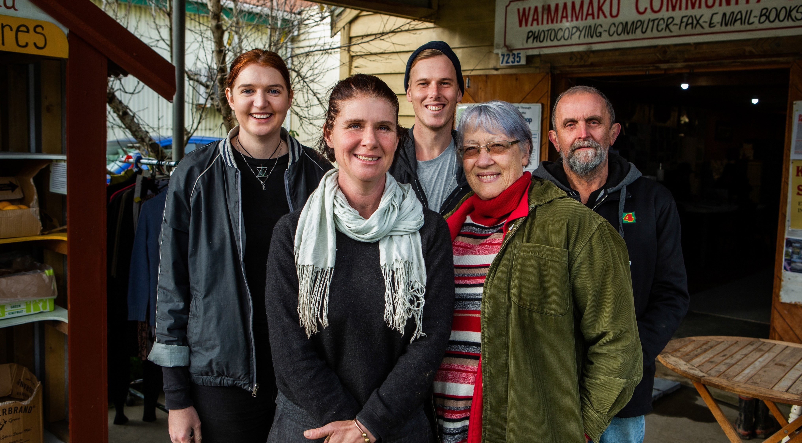

Wekaweka Valley Community Trust
Under $25,000 is a
Quick Response Grant
We aim to give you
a decision within
two months
Notes:
We have two funding pathways that are open all year, which you can apply for online at any time. The pathway you choose depends on how much money you’d like to apply for. Quick Response Grants (QRG) have streamlined processes that see grants working in communities as quickly as possible.
Since 1995, Wekaweka Valley Community Trust has been developing initiatives to improve the lives of the people of Waimamaku, a small town in between the Waipoua Forest and Opononi in the Far North.
https://www.foundationnorth.org.nz/stories/article/wekaweka-valley-community-trust

Slide 9
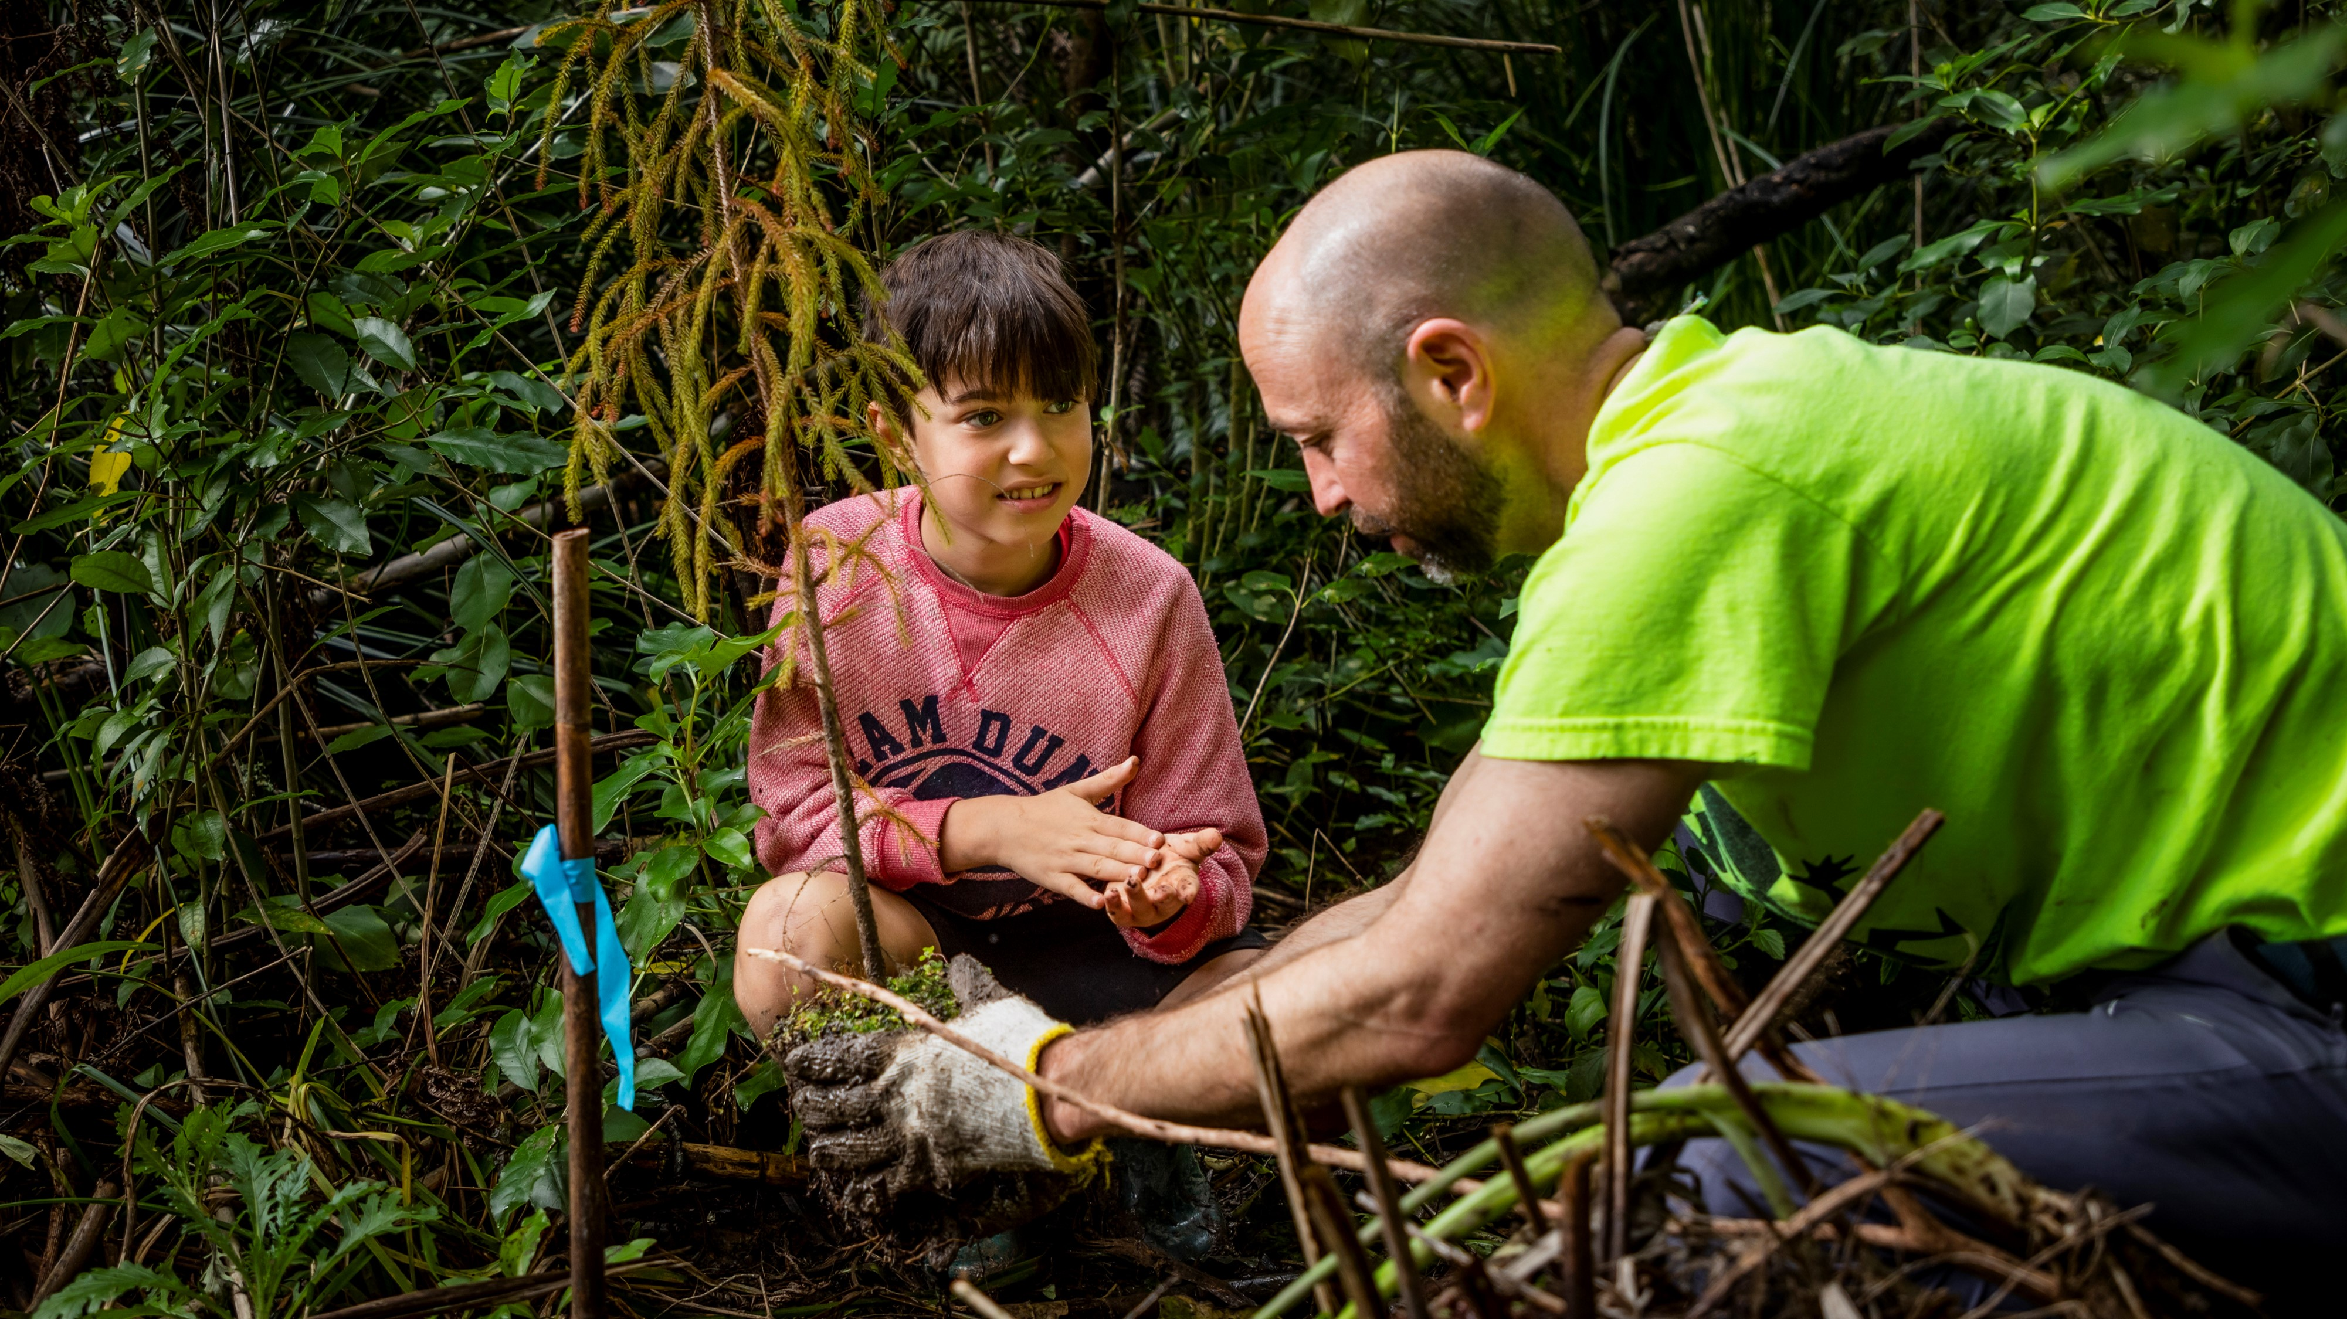

Over $25,000 is a
Community Grant
We aim to give you
a decision within
five months
Kaipātiki Project
Notes:
Please note – if you are thinking about applying for more than $100,000, we strongly encourage you to give us a call first to discuss your application.
From its beginnings over 23 years ago as a neighbourhood environmental action group, Kaipātiki Project in Birkdale on Auckland’s North Shore, is an innovative eco-hub running a thriving native plant nursery and facilitating local native ngahere, stream and estuary regeneration.
Despite the challenges, the impact of Kaipātiki Project’s regenerative environment programmes has amplified over the last 12 months; strengthening their offerings and increasing community engagement and participation in many ways.

Slide 10
Capacity and Capability Support
- Often organisations are looking to grow and develop in areas like governance, evaluation, budgeting and finance, leadership and management.
Notes:
Foundation North supports agencies like our Centre for Social Impact to deliver free training events and, webinars on these topics and more. Free toolkits and resources are available in Te Pūaha o te Ako, a knowledge hub on CSI's website.
Visit centreforsocialimpact.org.nz

Slide 11
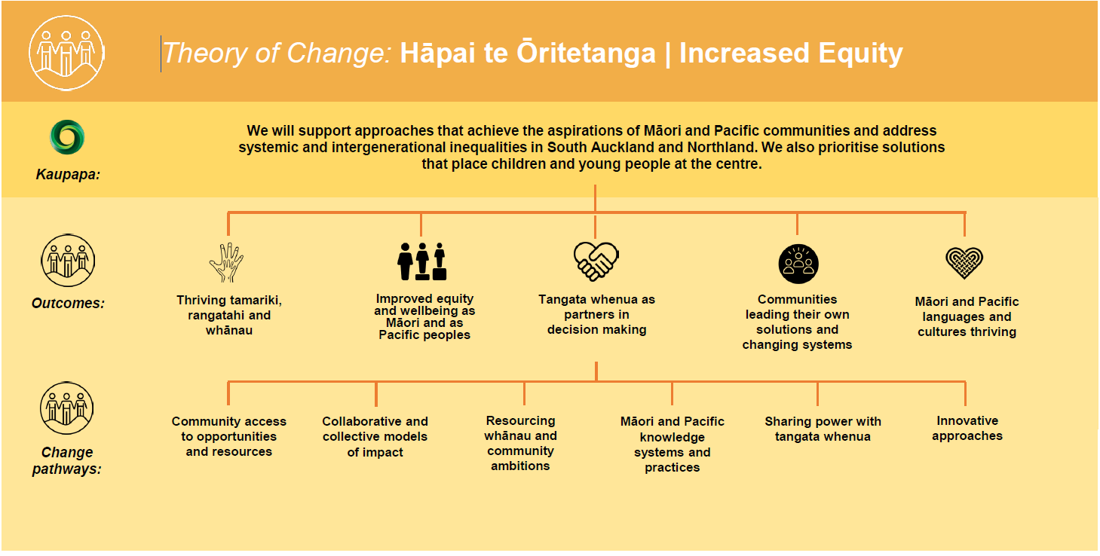
Notes:
To be updated by Curative
Some copy about the Theory of Change

Slide 12
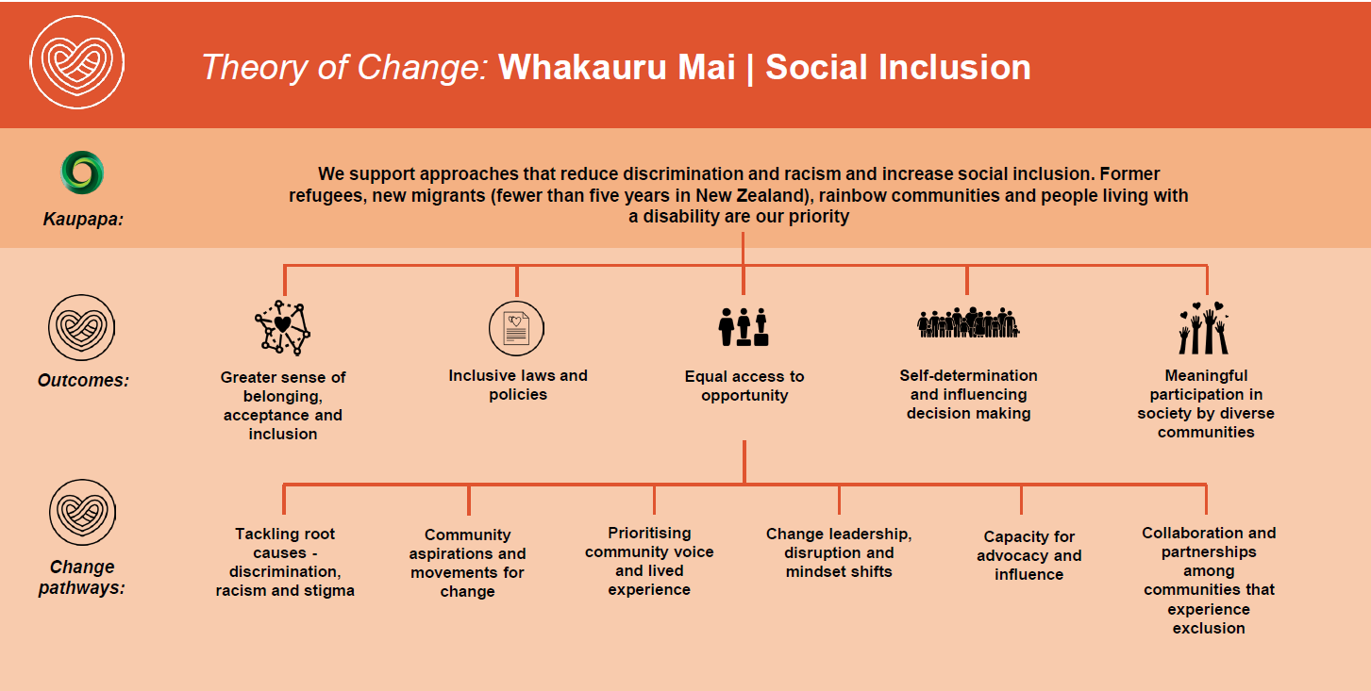

Slide 13
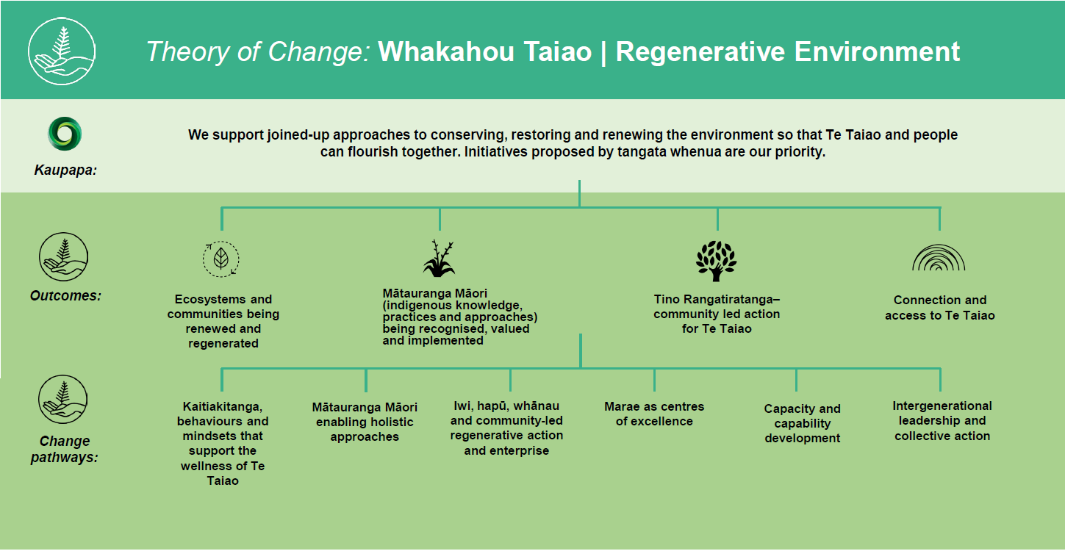

Slide 14
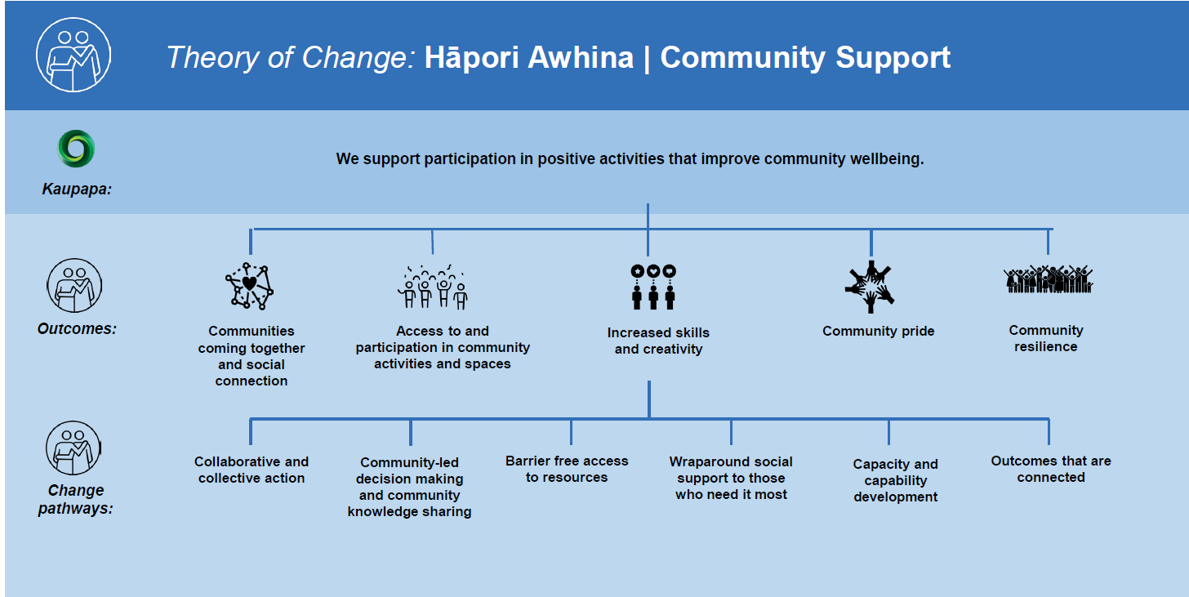

Slide 15
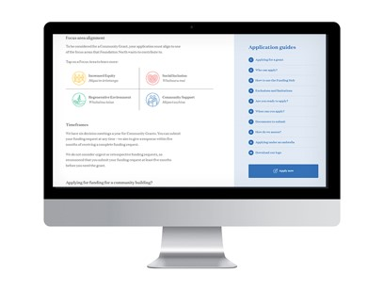
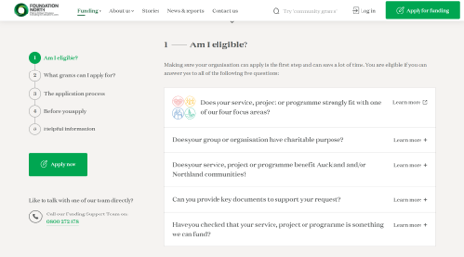
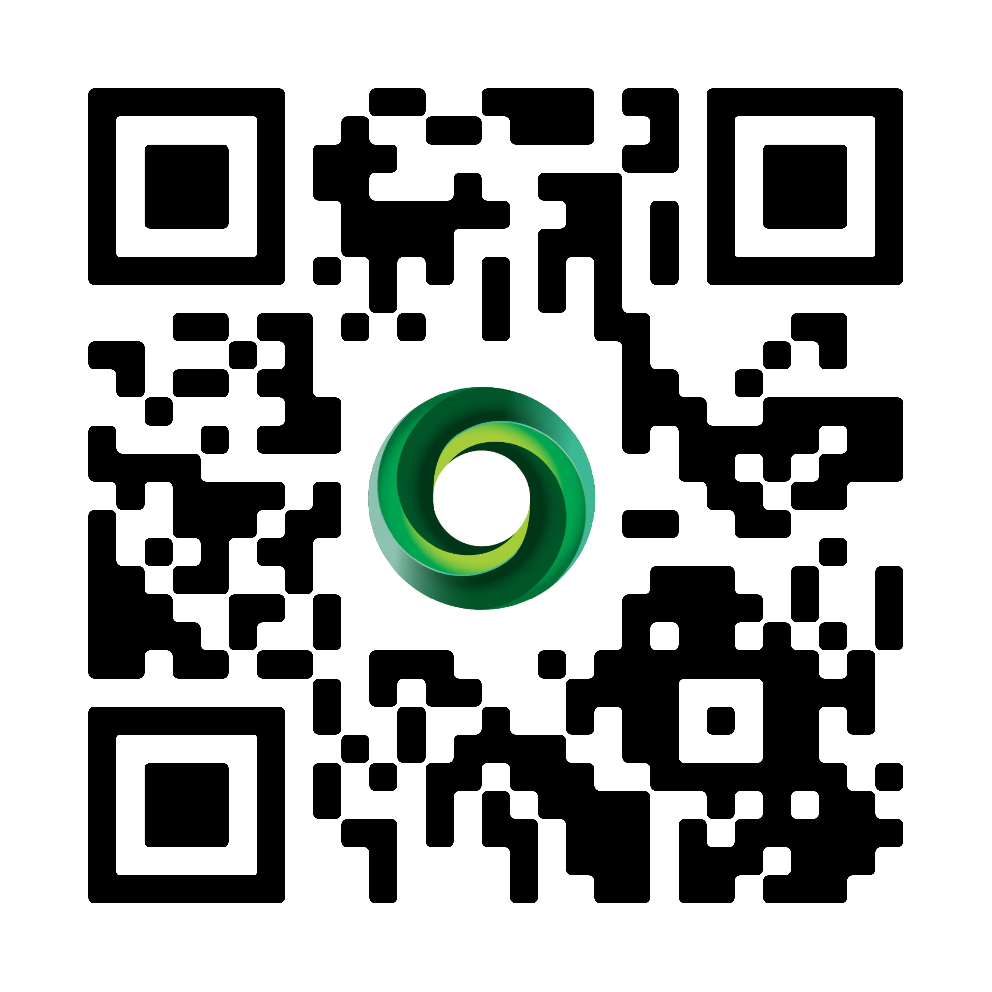
Useful Guides
Foundation North’s website has a wide range of application guides to support you through the process from the get go:

Slide 16

Application Tips
Who, When, What, Why and How?
Answer the question! Use our helper text to guide your answers
Supporting information and documents are easily understood and coherent to the application.
Do check our exclusion and limitation policy.
Organisations are eligible to receive a grant once every 12 months.
Lastly, our team is here to work with you and support you!

Slide 17
Nga Mihi
W: foundationnorth.org.nz
E: info@foundationnorth.org.nz
P: 0800 272 878
Kia ora

