Slide 1
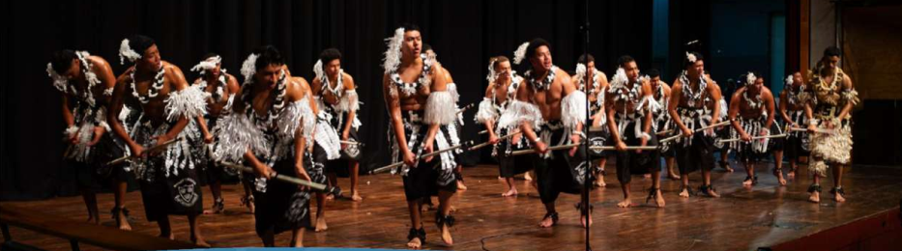
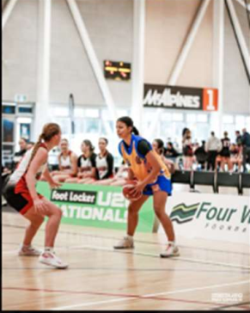
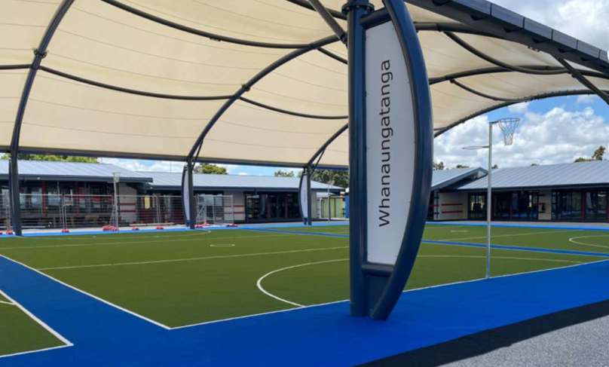

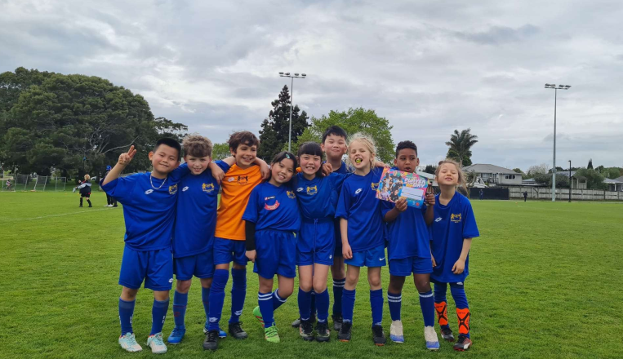
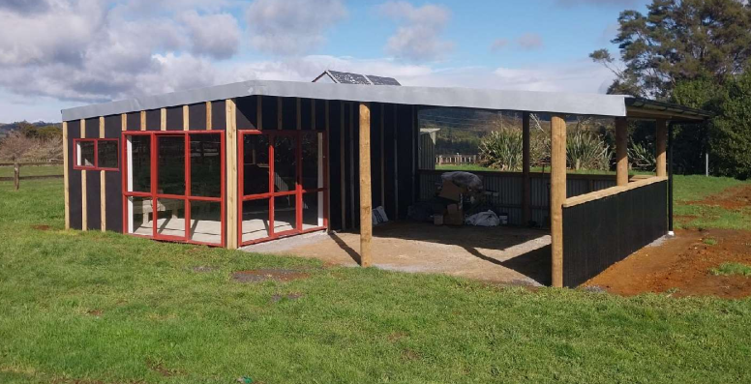

Slide 2
Funding Categories
Sport (amateur sports teams/clubs)
Community
Health, Welfare & Rescue Services
Research and Education
Arts & Culture
Environment & Animals

Slide 3
Funding Rounds
The NPC (Net Proceeds Committee) meets every month to consider applications
Meetings are usually held in the last week of the month
Applications must be received by the 25th day of the month
These are considered at the following month’s meeting eg. Apply by 25th February, discussed at March meeting, funded beginning of April
See our website for funding rounds

Slide 4
Application Requirements
Applications must be submitted via our online portal
Only 1 application per month will be considered
Limit of 4 applications per year
Any previous outstanding accountability should be completed prior to consideration
Applicants must be an Incorporated Society or have some other legal standing

Slide 5
General Info
We generally fund three months of costs or an event within three months of the meeting date
Funding cannot be granted for events that have already occurred
Any payments made prior to the meeting will be considered retrospective (including deposits on bookings)
Results will be communicated by email – no verbal results
Accountability documents are due within three months
You can call or email us anytime, see our website for contact info

Slide 6
Other Information
Funds must be used for the specific purpose for which you applied
Suppliers used must be as per approved quote (notified with approval letter)
Any funds not used for the approved purpose must be refunded
In the event funding is granted from another organisation for the same purpose, a refund must be made

Slide 7
Funding Regions
Priority is given to applications that are within the TLA (Territorial Local Authorities) areas that we have venues in
We also fund National organisations
Check that we have a venue in your area before submitting an application
Venues do change so check each time

Slide 8
What we can fund
Event costs – portaloos, fencing, security, stage hire, traffic management, etc
Tournament costs – van hire, accommodation, flights
Sports equipment – balls, goals, etc
Uniforms – playing uniforms only (no coaches, managers, training)
Salaries
Building costs
Playgrounds and play equipment
IT equipment
And more

Slide 9
Unauthorised Purpose
Food and entertainment (including meals provided with accommodation)
Prize money and / or events where cash prizes are offered
Fuel/Mileage, first aid kits, physio, any personal items such as drink bottles, mouthguards, socks
Dress uniforms or those items that do not remain with the organisation
Individual sports persons
Professional sports or high-performance athletes
Events or trips that are predominantly social in nature
See our website for more

Slide 10
How to make your application
Find our portal on our website, www.fourwindsfoundation.co.nz
Ensure that you have all the required information and that it is signed if necessary
All quotes and signed documents must be less than 3 months old
Select the correct purposes, TLAs, etc in the application
Read the questions on the application
Keep your organisation settings up to date, ie. Number of members

Slide 11
Documentation Requirements
Confirmation of bank account (bank deposit slip or similar verification)
Resolution/Declaration from your organisation – we prefer for you to use our templates which can be found on our website and portal
Two quotes detailing items applied for (where applicable)
Job contract including job description (where applicable)
Signed Financial Statements (most current year available)
See our website for further details and requirements

Slide 12
What to do once you’ve applied
Check you are receiving our notifications by email
Read and respond to any questions or requests we send you in a timely manner
If you receive funding, check your approval letter for approved supplier, conditions etc
Submit your accountability on time
Request a variation if you need to change a supplier or request an extension
Let us know if a contact person has left your organisation
Let us know if you receive other funding for the same purpose

Slide 13
How can you thank us
Submit photos of how you have used the funds – and ensure we have permission to use these on our website etc
Download the Four Winds logo from our website for use in your newsletter or social media
Post on your social media accounts about our grants and how they will help you
Install signage on vehicles or on buildings funded by Four Winds
Borrow our Four Winds flags for your event
Support your local venues
Submit your accountability on time
Contact us directly for further advice

